Slide 1


Slide 2


Slide 3


Slide 4
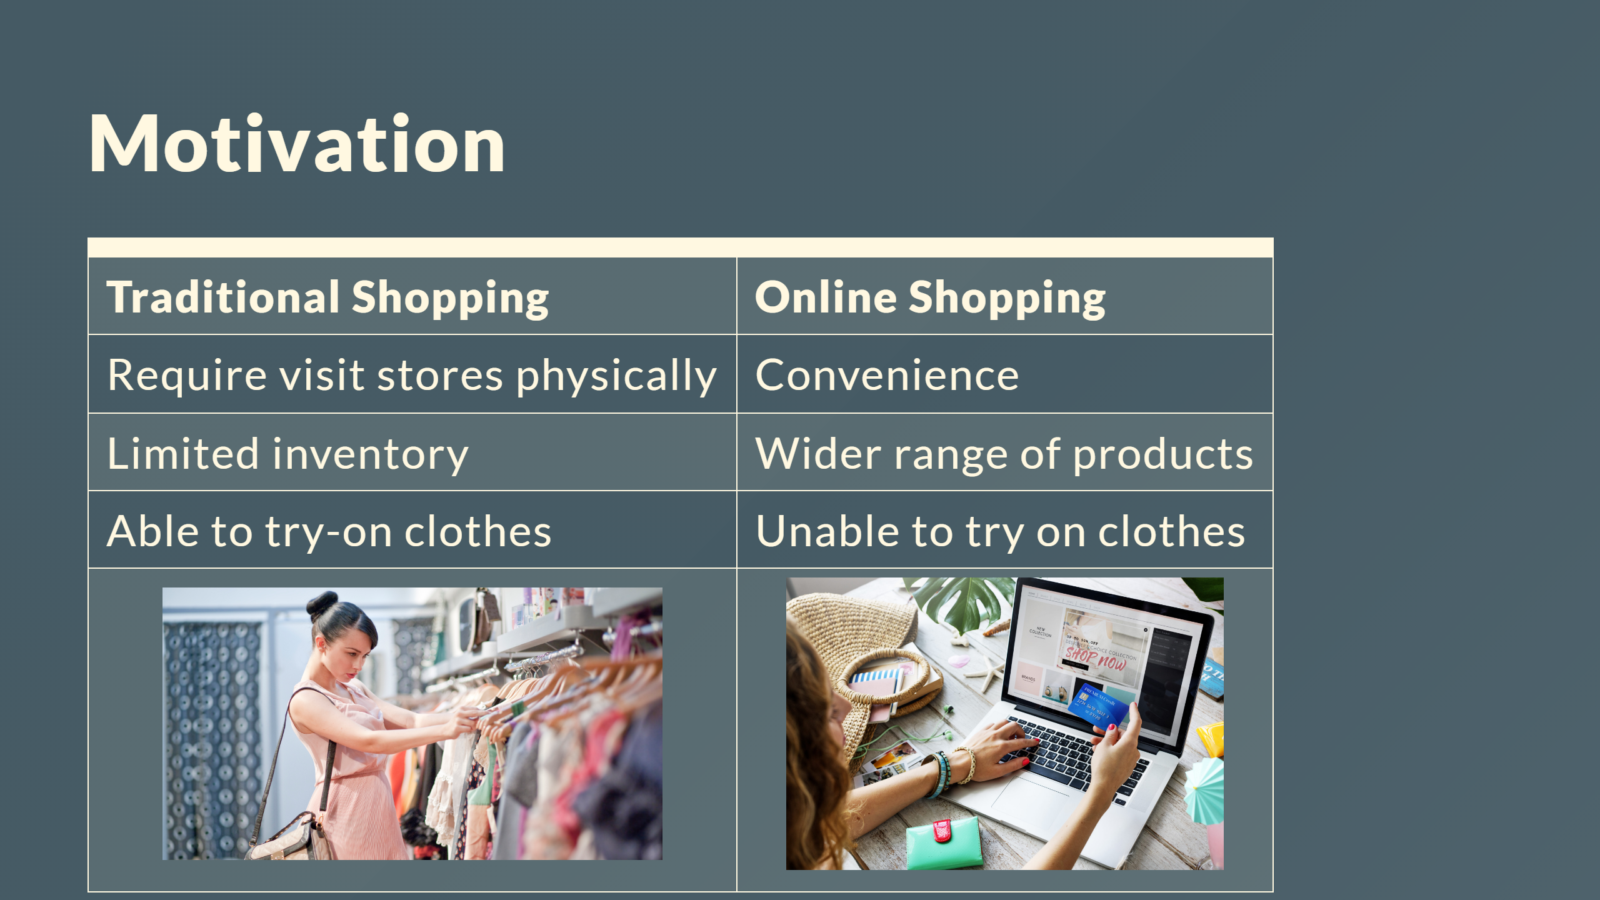

Slide 5
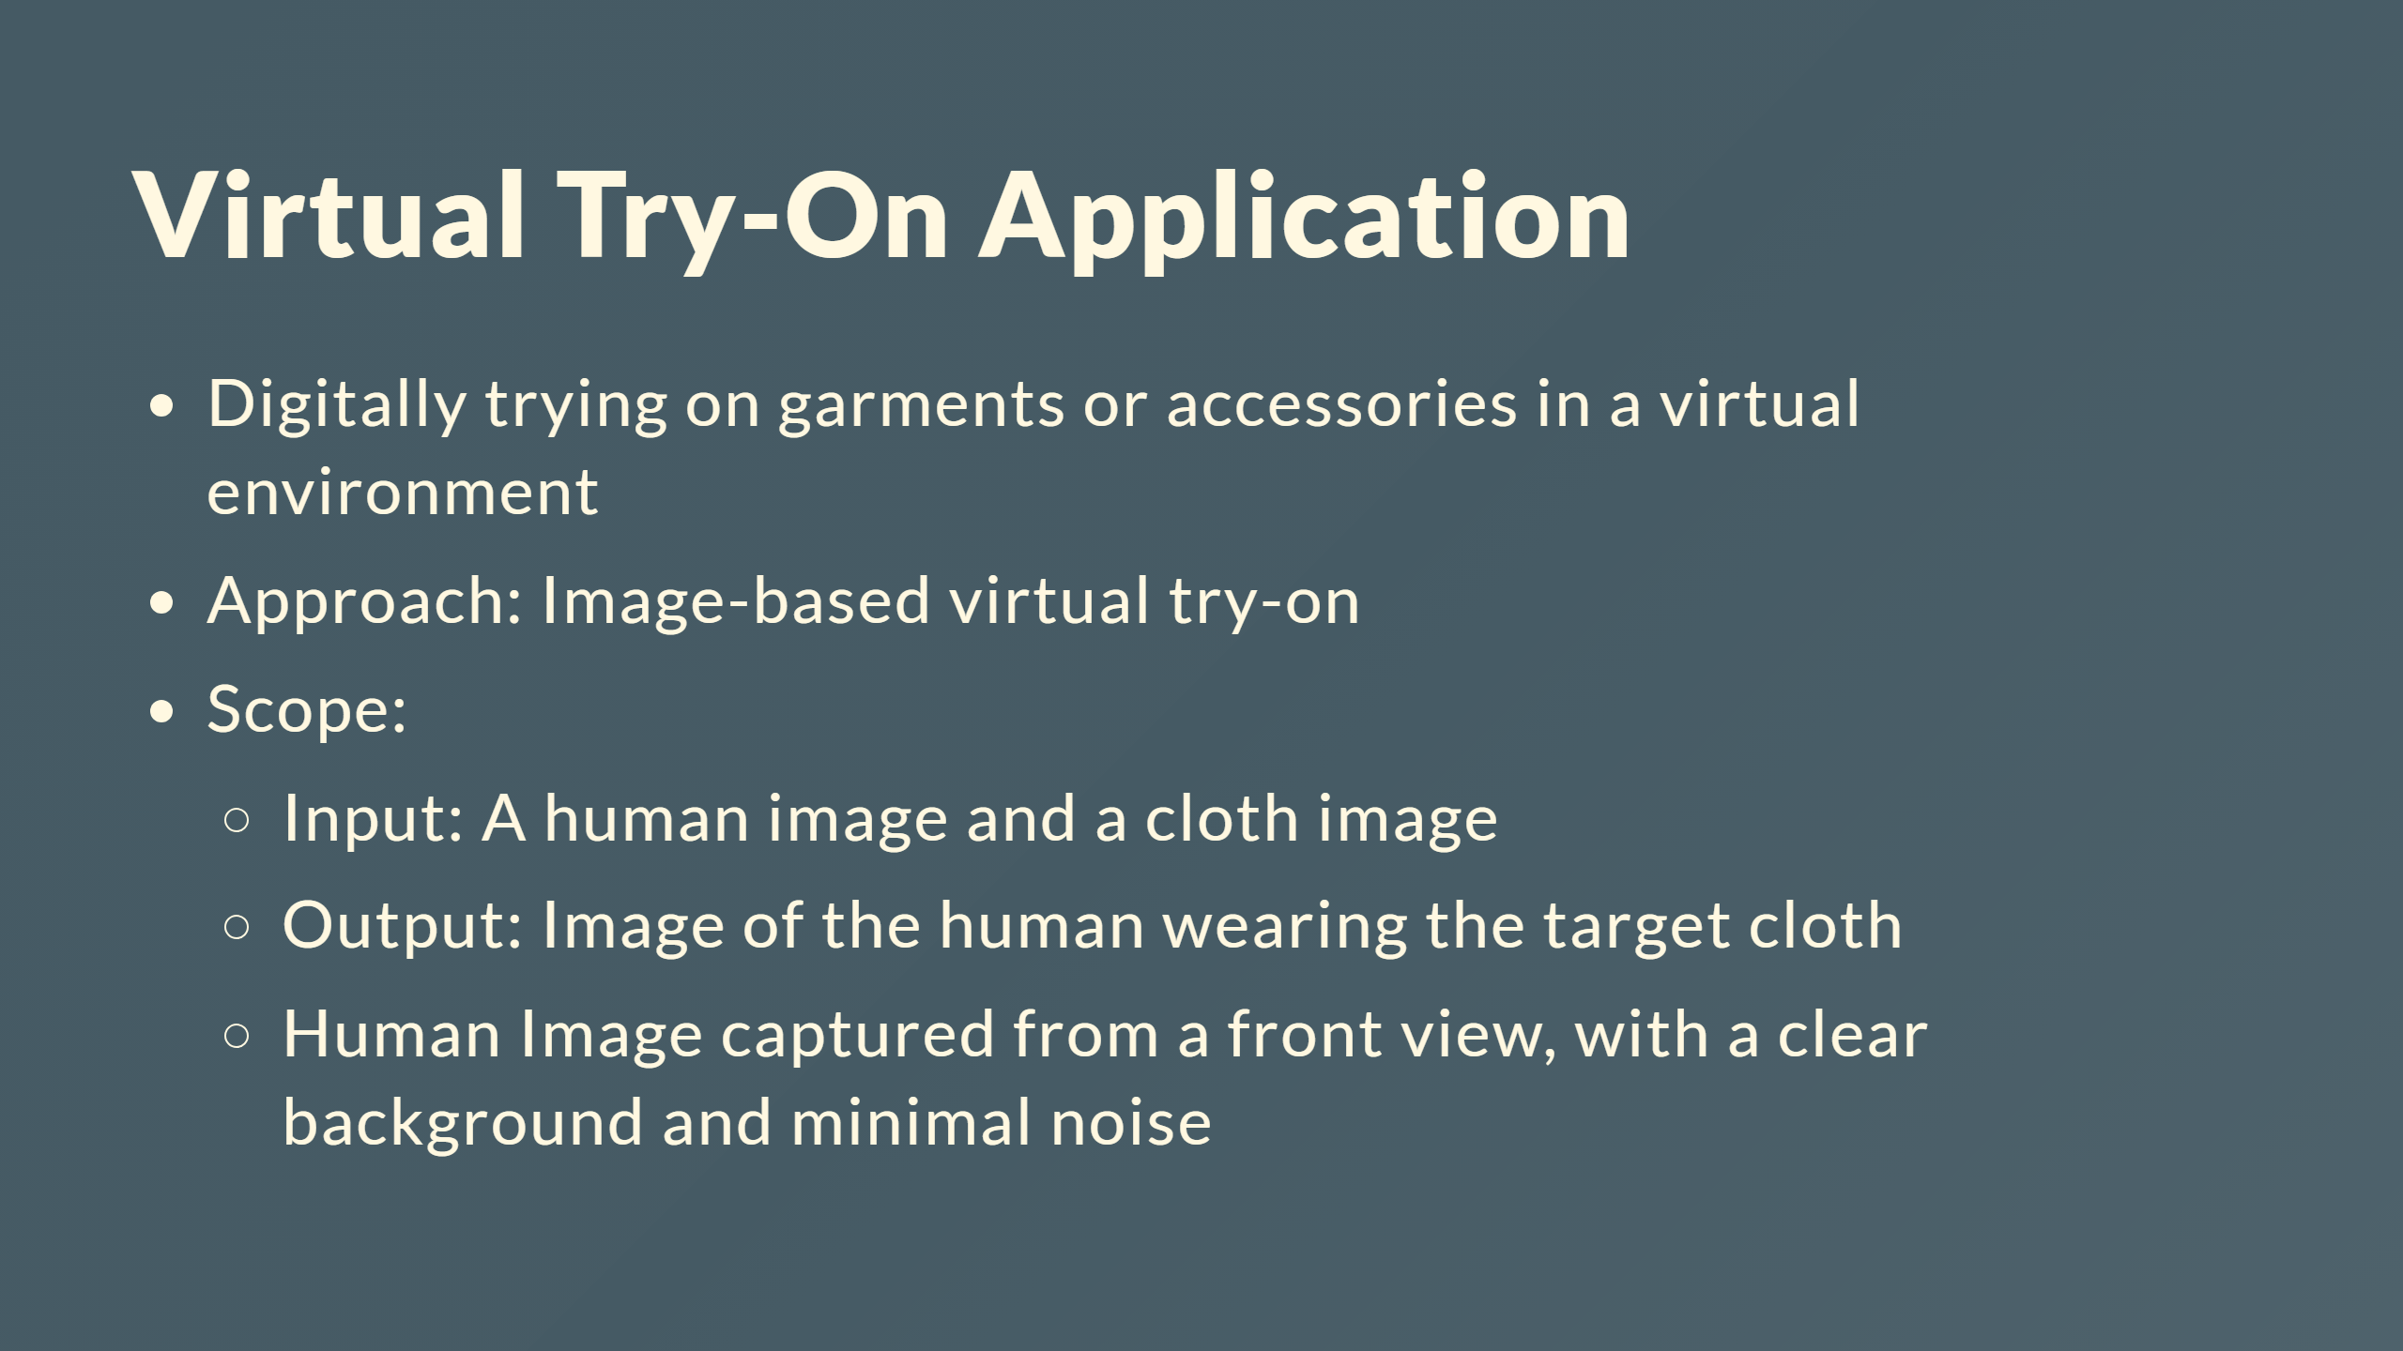

Slide 6
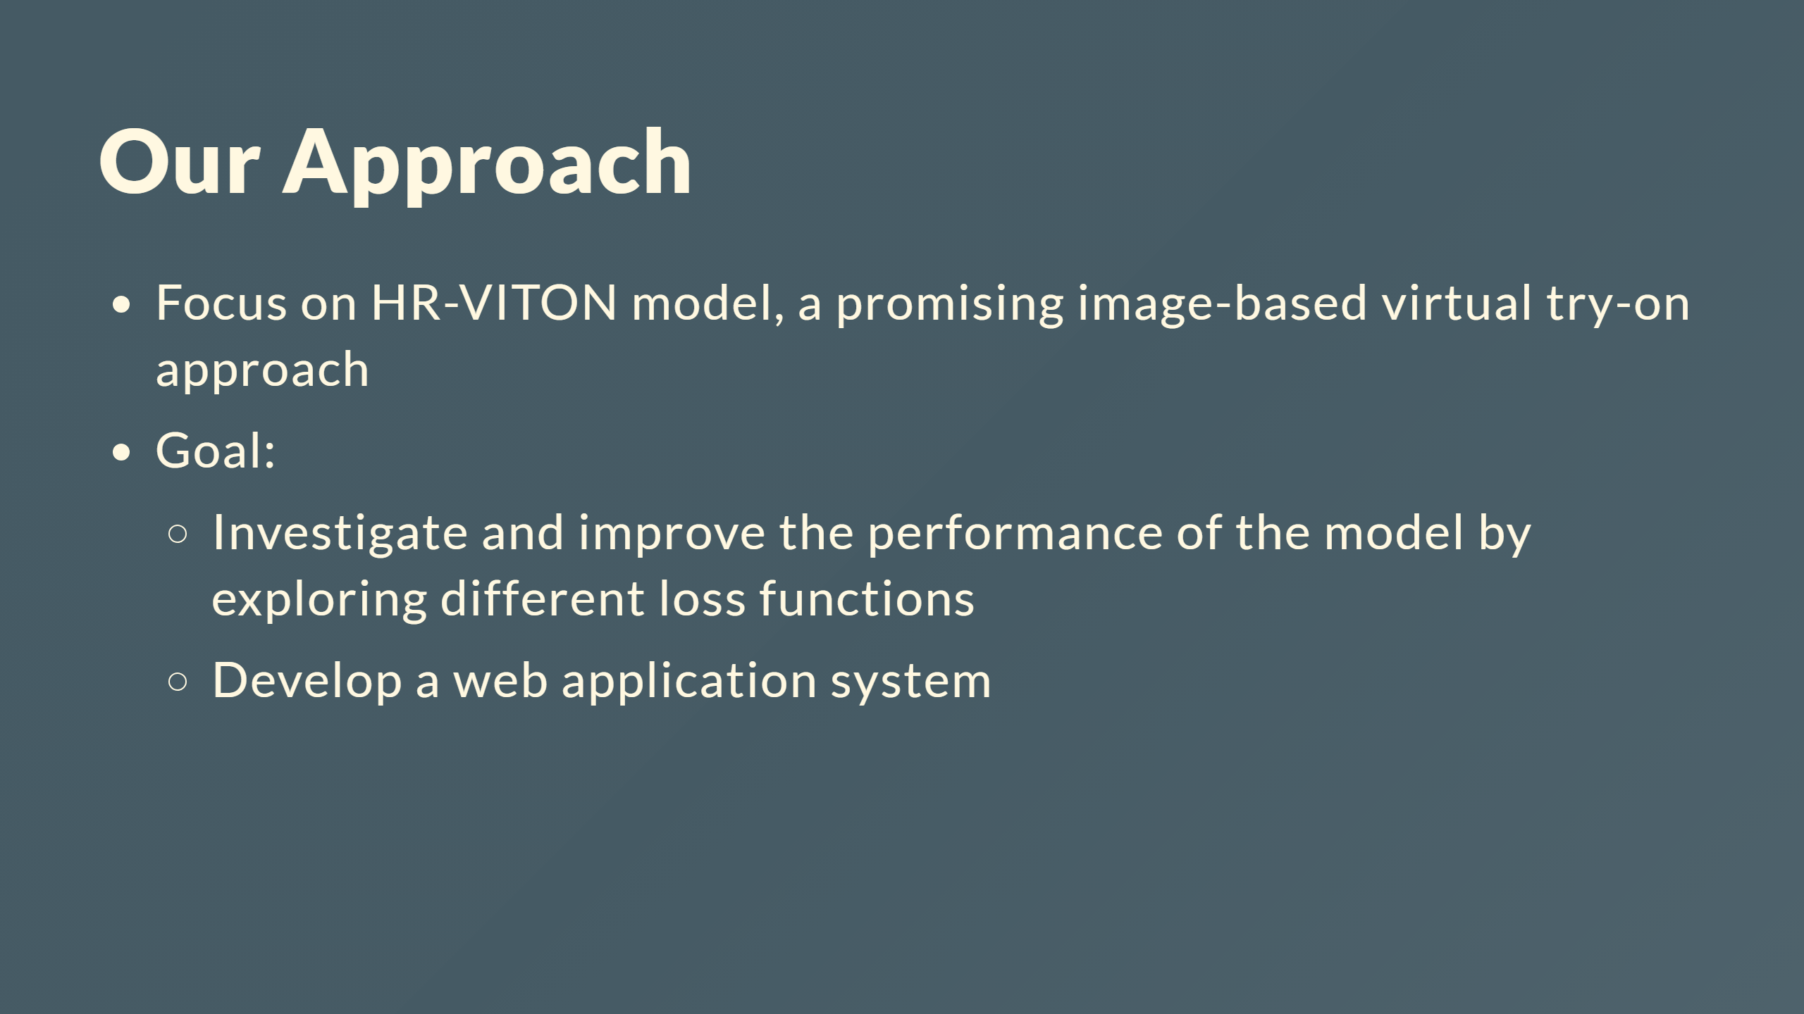

Slide 7


Slide 8
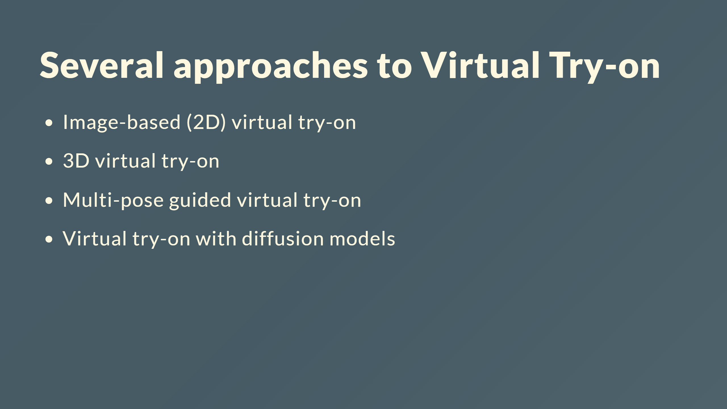

Slide 9
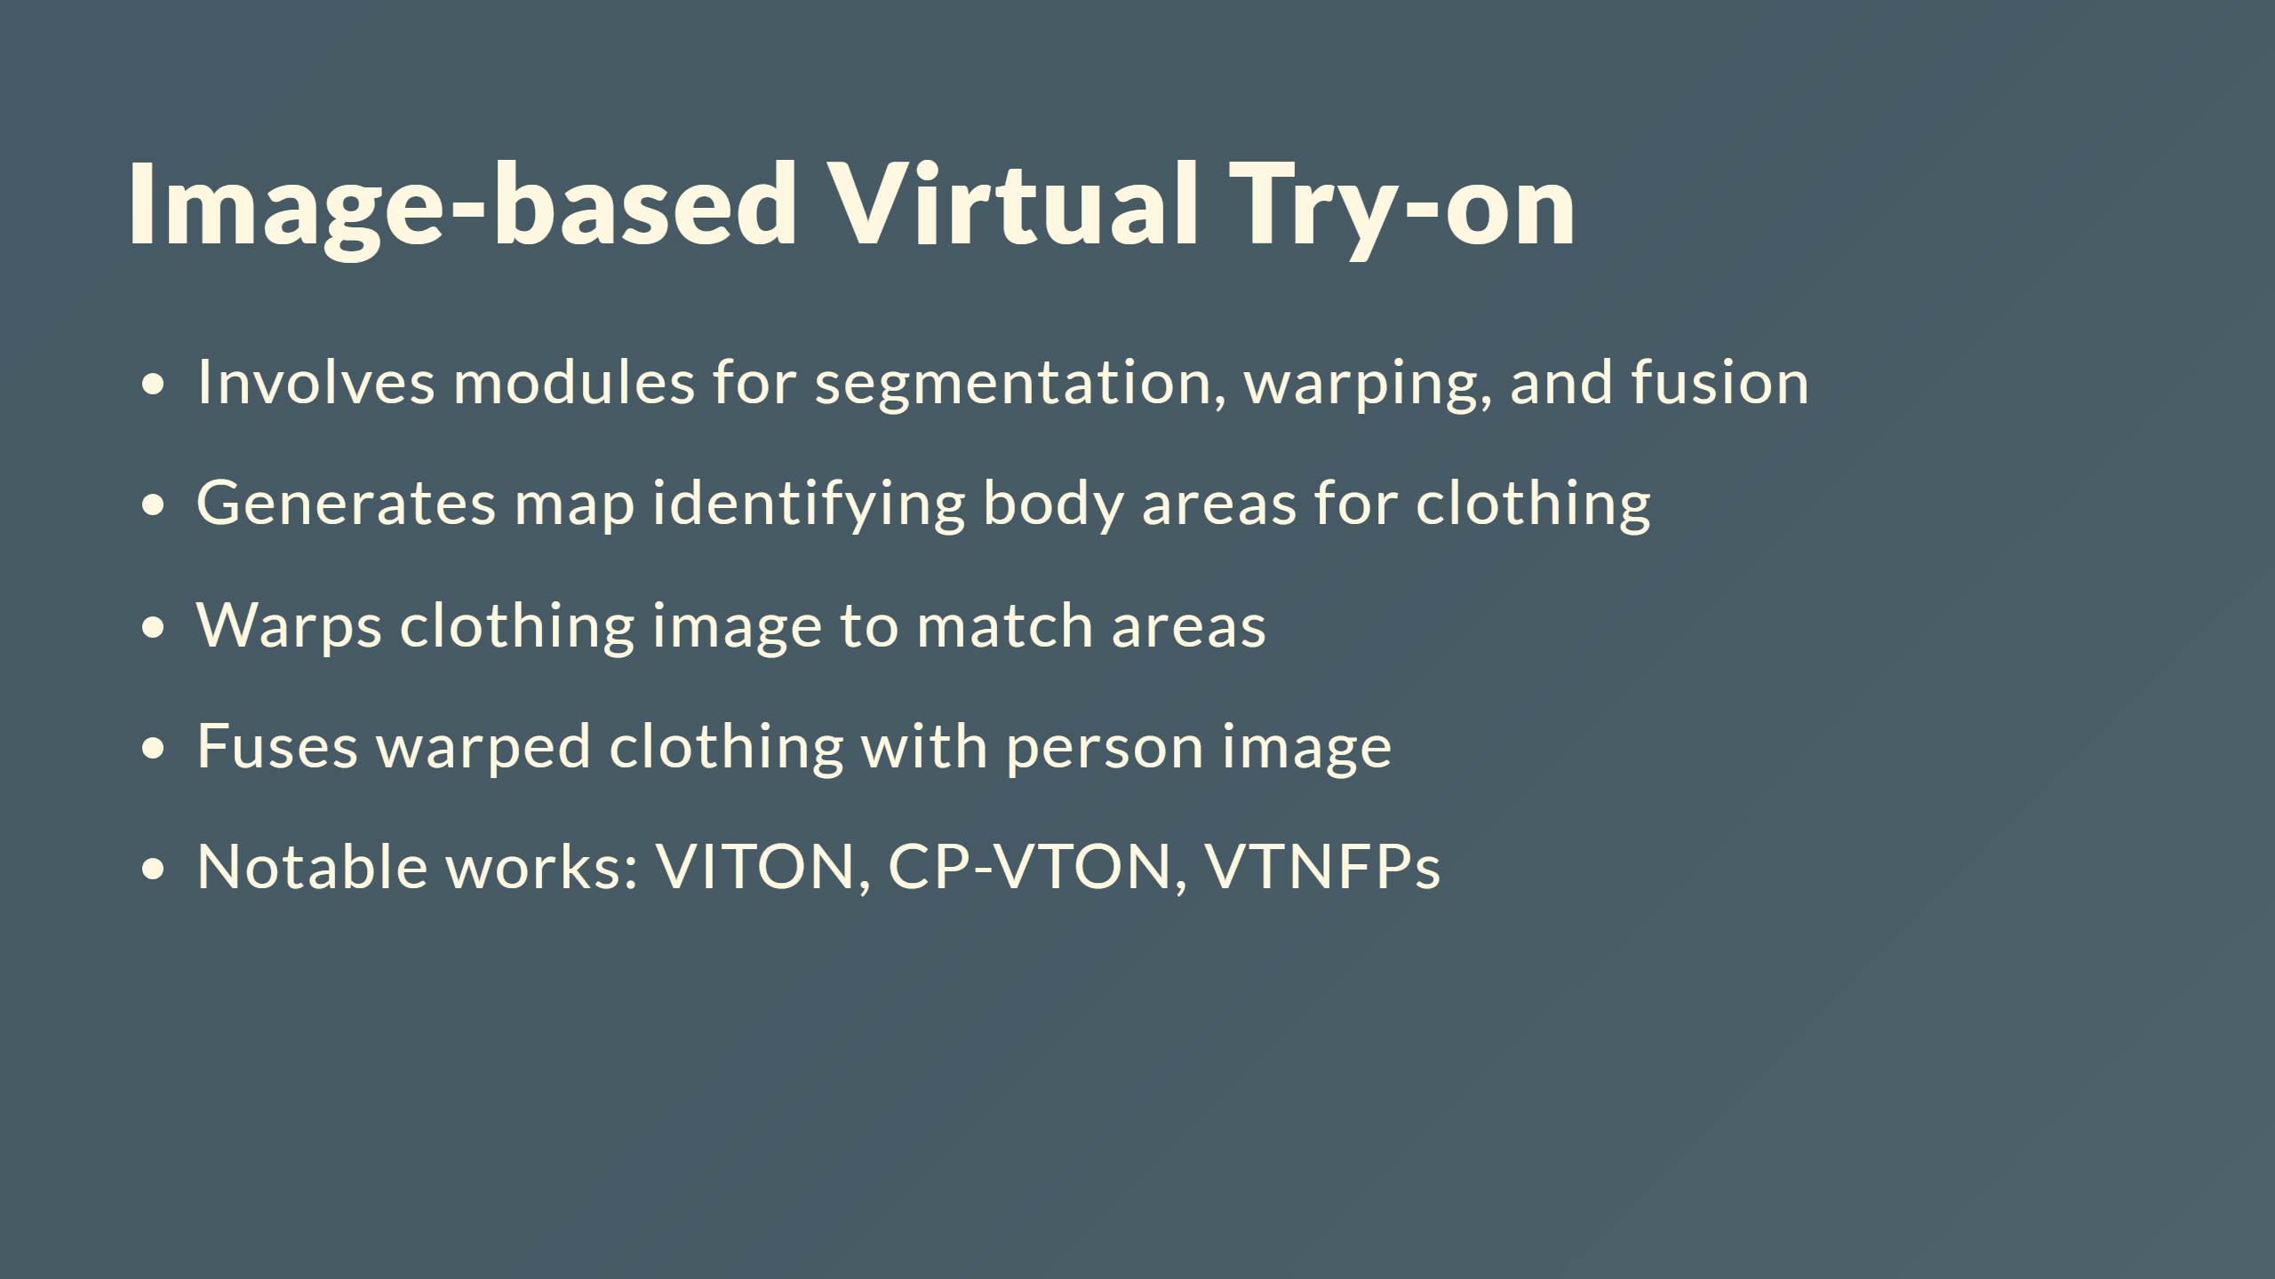

Slide 10
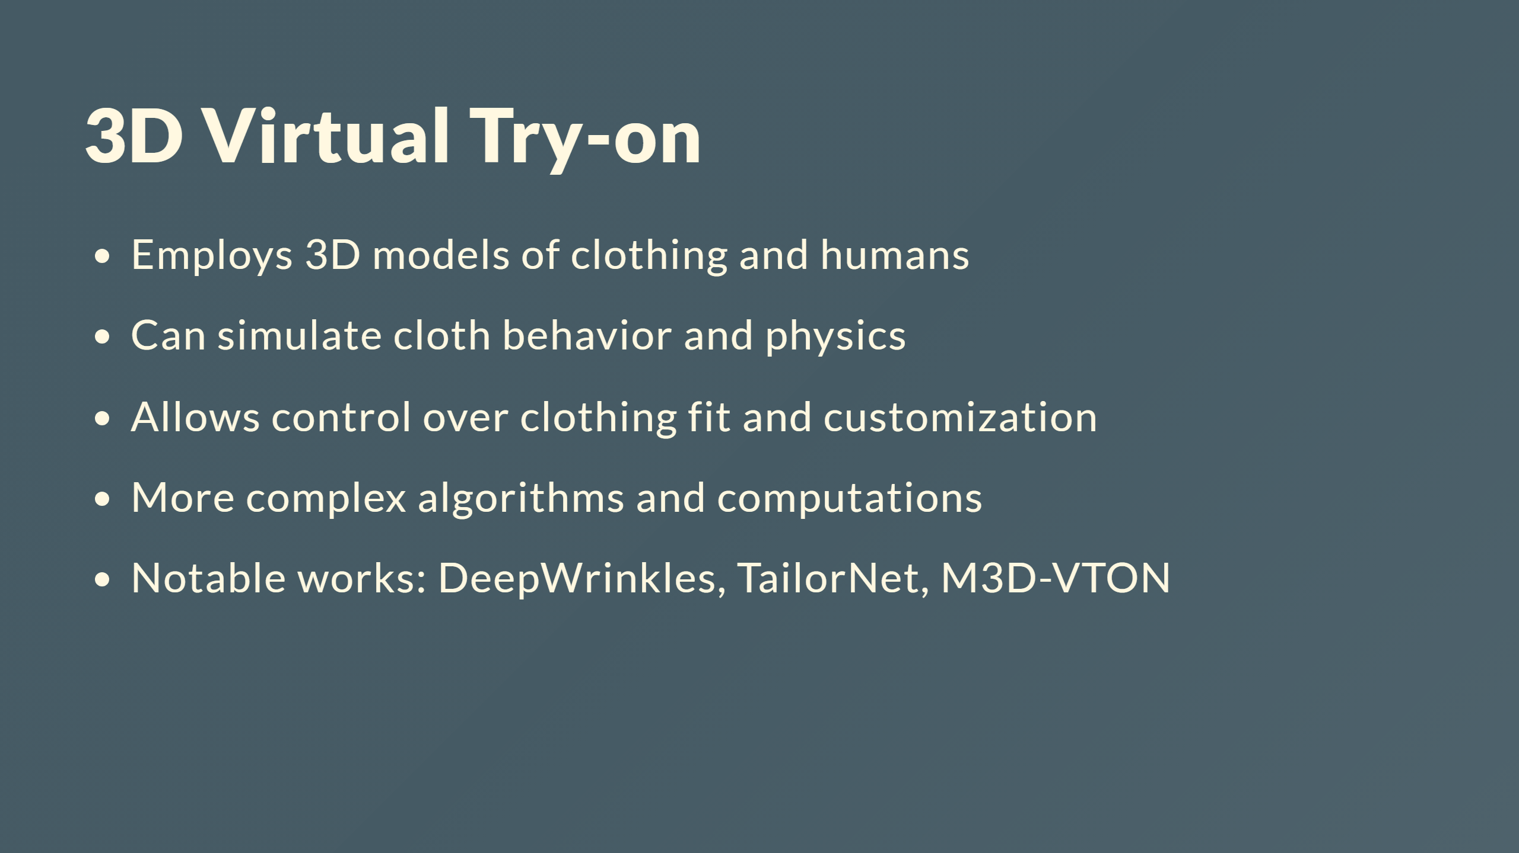

Slide 11
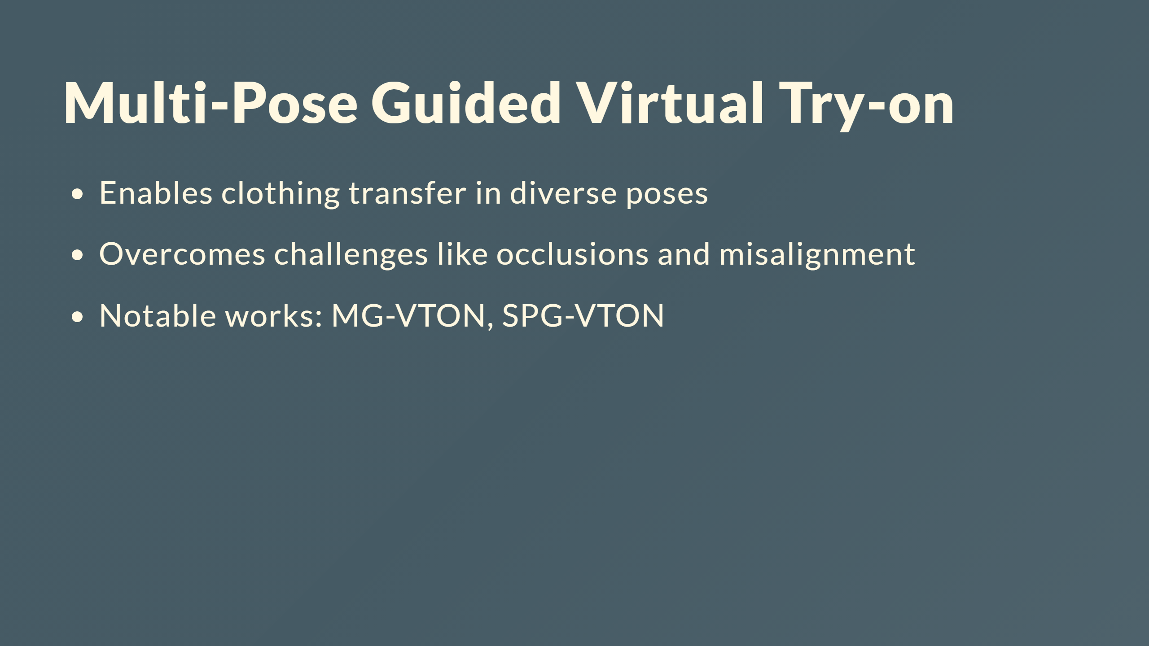

Slide 12
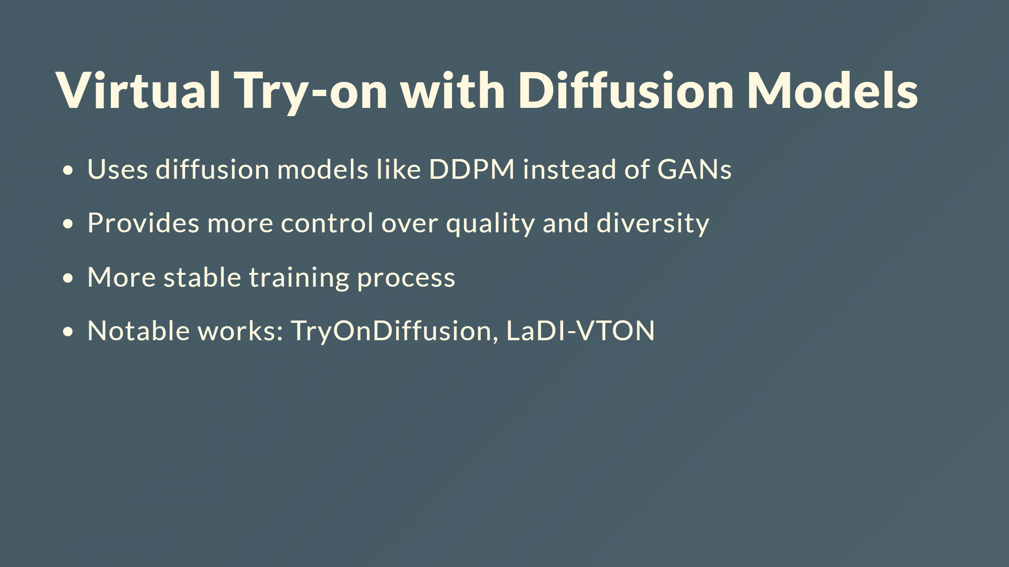

Slide 13
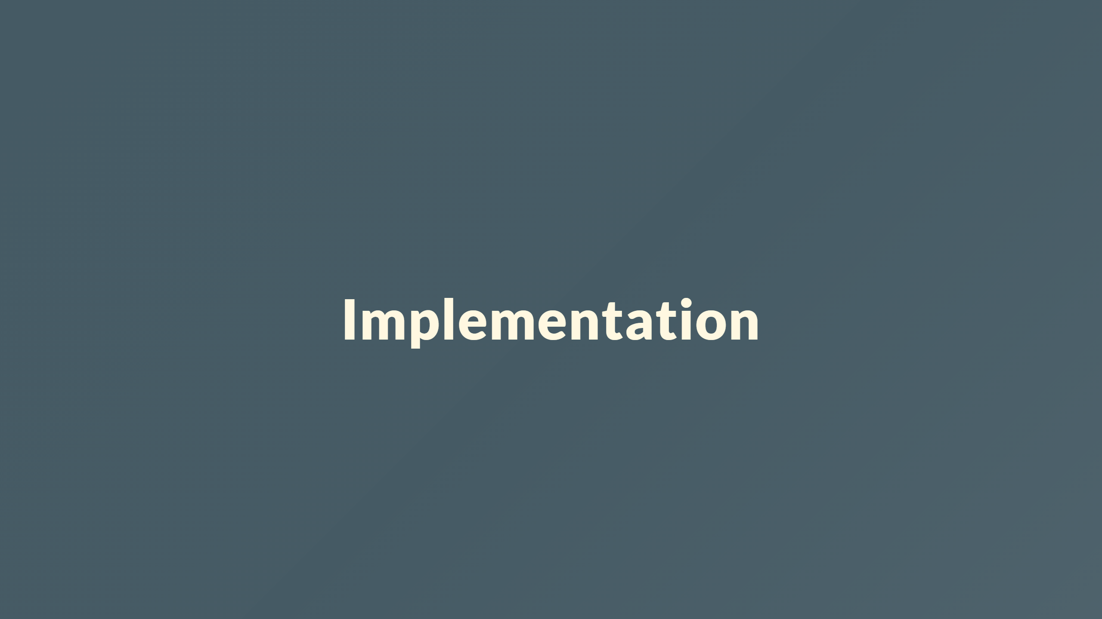
Notes:
--- # Chapter 3: Foundation --- ## Generative Adversarial Networks (GANs) ![h:250 centernotop](Network.png) <div style="color: white; font-size: 30px; margin-top: 30px; text-align: center; "> <b>Gan architecture</b> </div> - Generator network (G) - Discriminator network (D) --- # Generator Network - Creates synthetic samples $x = G(z)$ - Learns to map noise $z \sim p_z$ to real data distribution $p_{data}$ - Output becomes increasingly realistic during training --- # Discriminator Network - Classifies real vs. generated samples - Identifies features that characterize real data - Optimized to accurately classify real and fake samples --- # GAN Formulation Generator objective: $$\min_G \mathbb{E}_{z \sim p_z(z)} [ \log(1 - D(G(z)))]$$ Discriminator objective: $$\max_D \mathbb{E}_{x \sim p_{data}(x)}[\log D(x)] + \mathbb{E}_{z \sim p_z(z)}[\log(1 - D(G(z)))]$$ Adversarial minimax game between G and D. --- # Training GANs - Generator aims to minimize loss by fooling discriminator - Discriminator aims to maximize loss by detecting fake samples - Loss gradients update network parameters --- # GAN Problems Common challenges: - Mode collapse - Non-convergence - Vanishing gradients Ongoing research to address these issues. --- # GAN Loss Variants Modified losses can improve training: - Least squares loss - Hinge loss - Feature matching loss Help address vanishing gradients, mode collapse, etc. ---

Slide 14
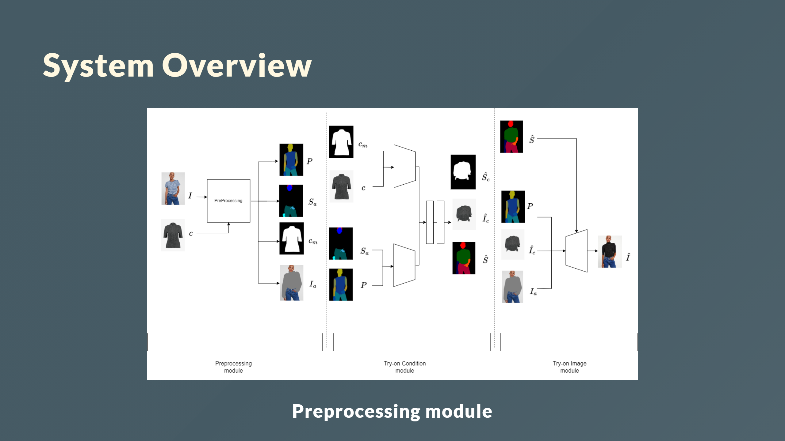

Slide 15
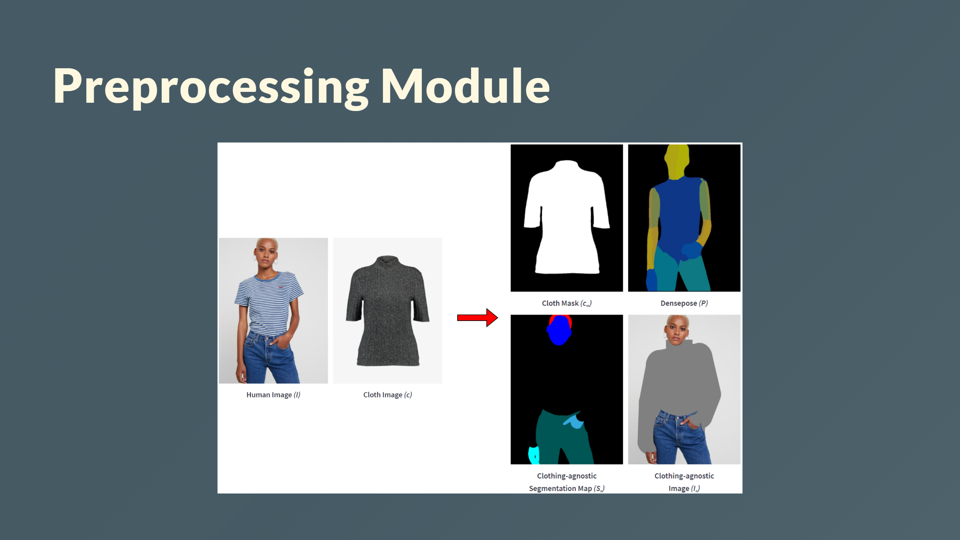

Slide 16
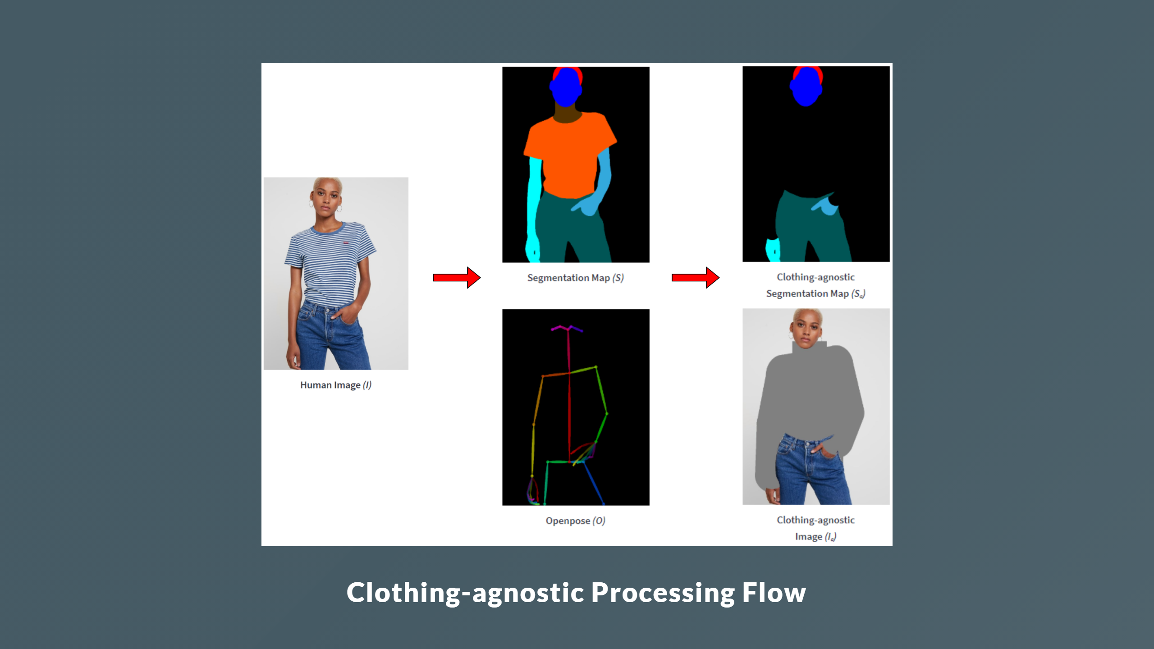

Slide 17
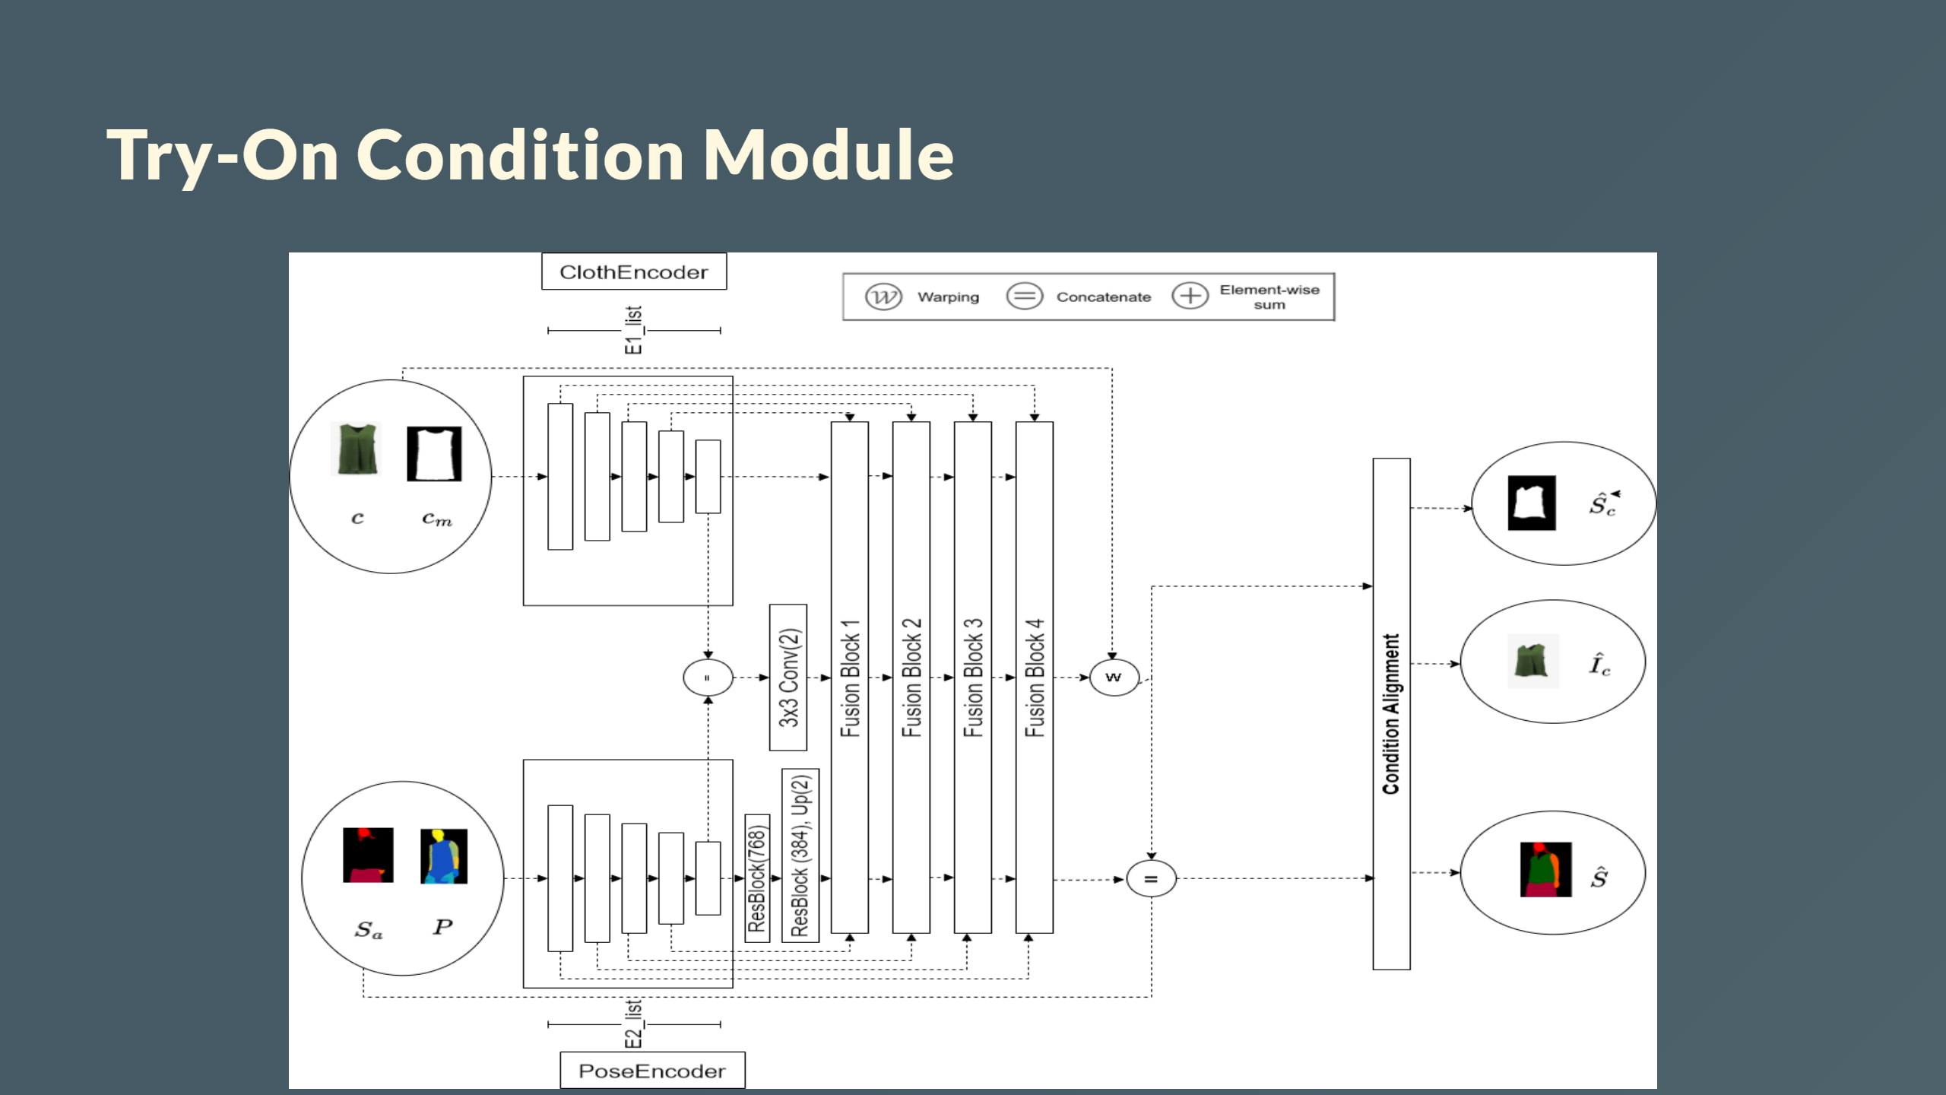
Notes:
Input: - Clothing image $c$, Cloth mask $c_m$ - Denpose $P$ Output: - Warped clothing image $\hat{I}_c$ - Cloth mask segmentation $\hat{S}_c$ - Segmentation map $\hat{S}$ --- # Generator Architecture - Two encoders - Four feature fusion blocks - Condition Aligning stage <div style="color: white; font-size: 30px; margin-top: 150px; margin-left:700px "> <b>Generator Architecture</b> - Two encoders - Four feature fusion blocks - Condition Aligning stage </div>

Slide 18
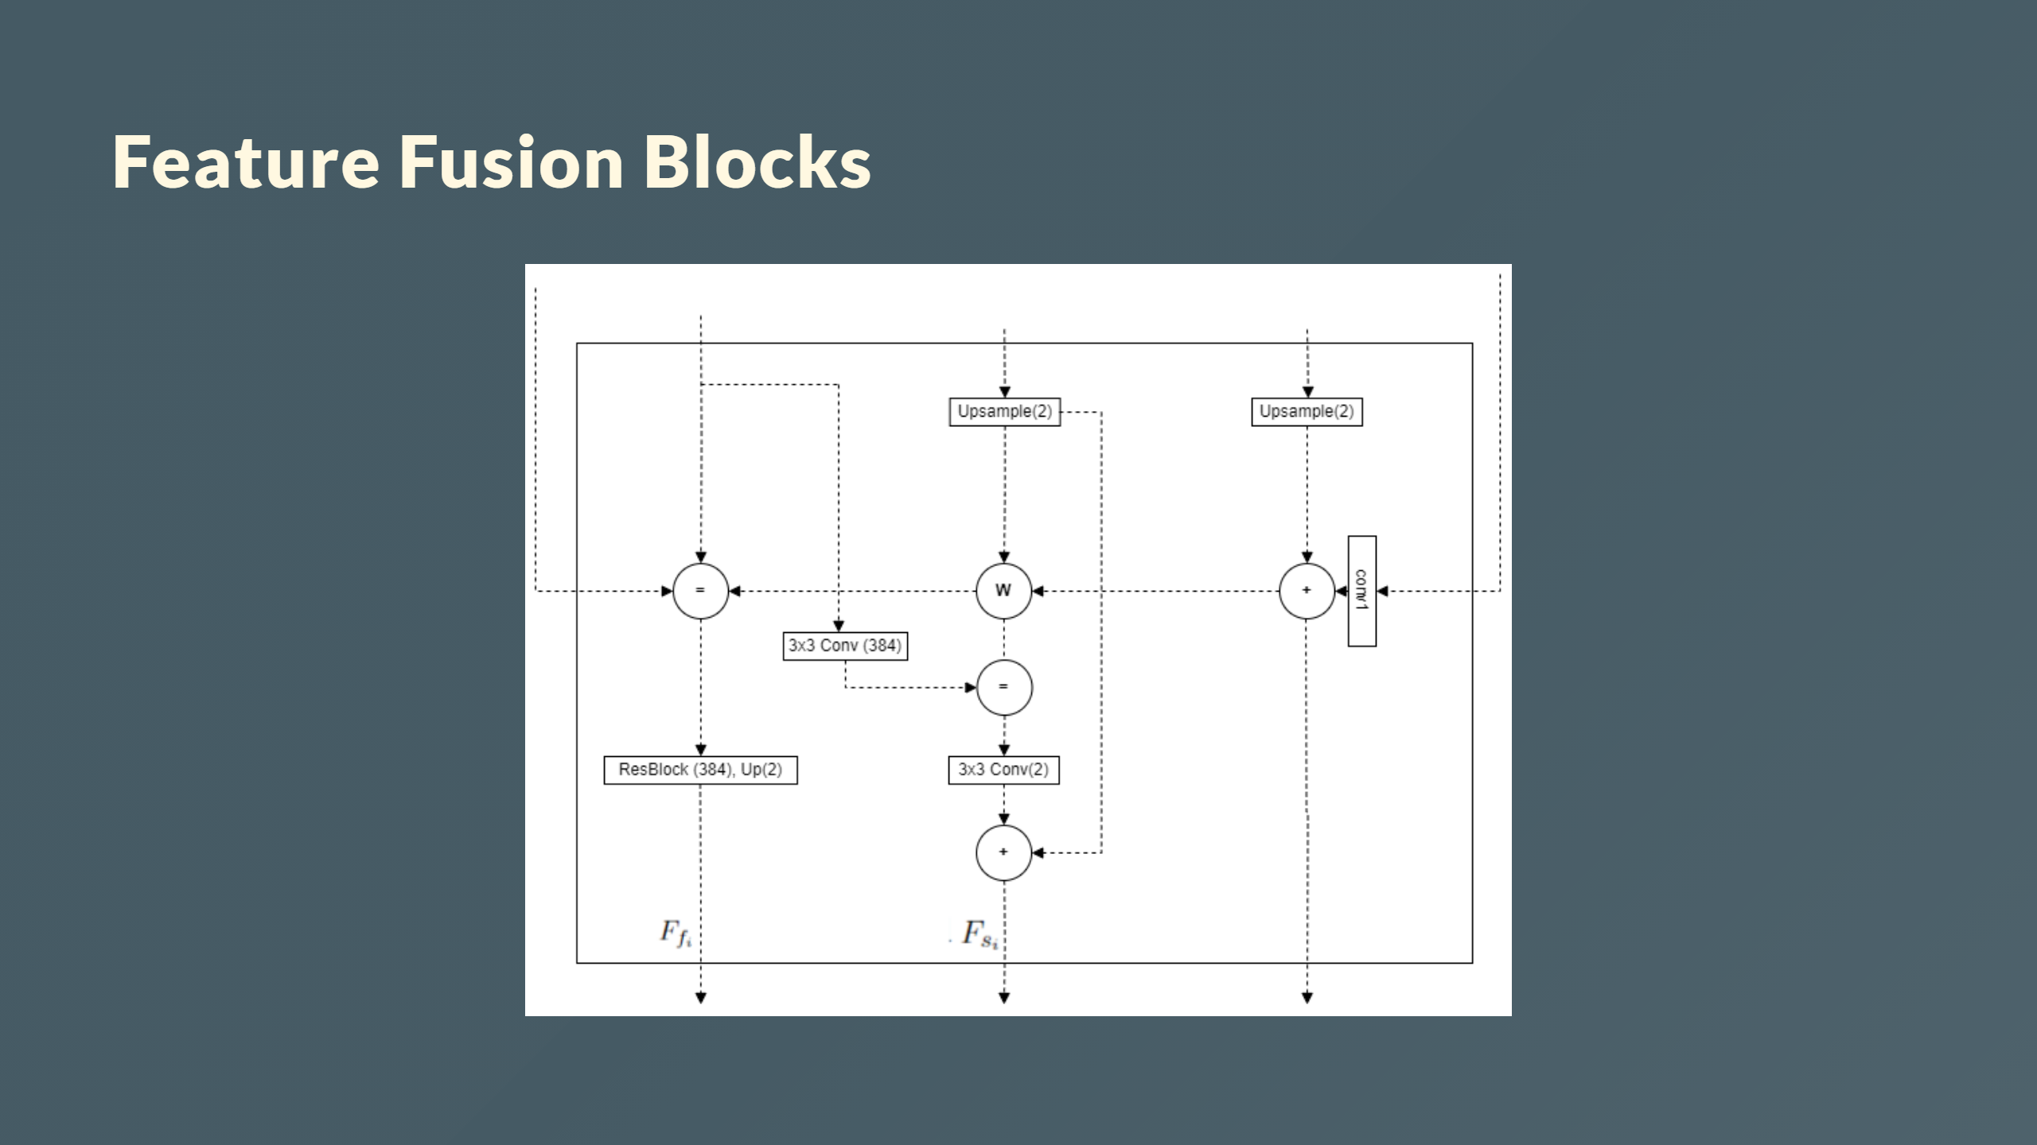
Notes:
- Has two routes: the flow pathway and the seg pathway. - Takes two inputs, $F_{f_{i-1}}$ and $F_{s_{i-1}}$. - The two pathways communicate with each other to determine $F_{f_i}$ and $F_{s_i}$ simultaneously.

Slide 19
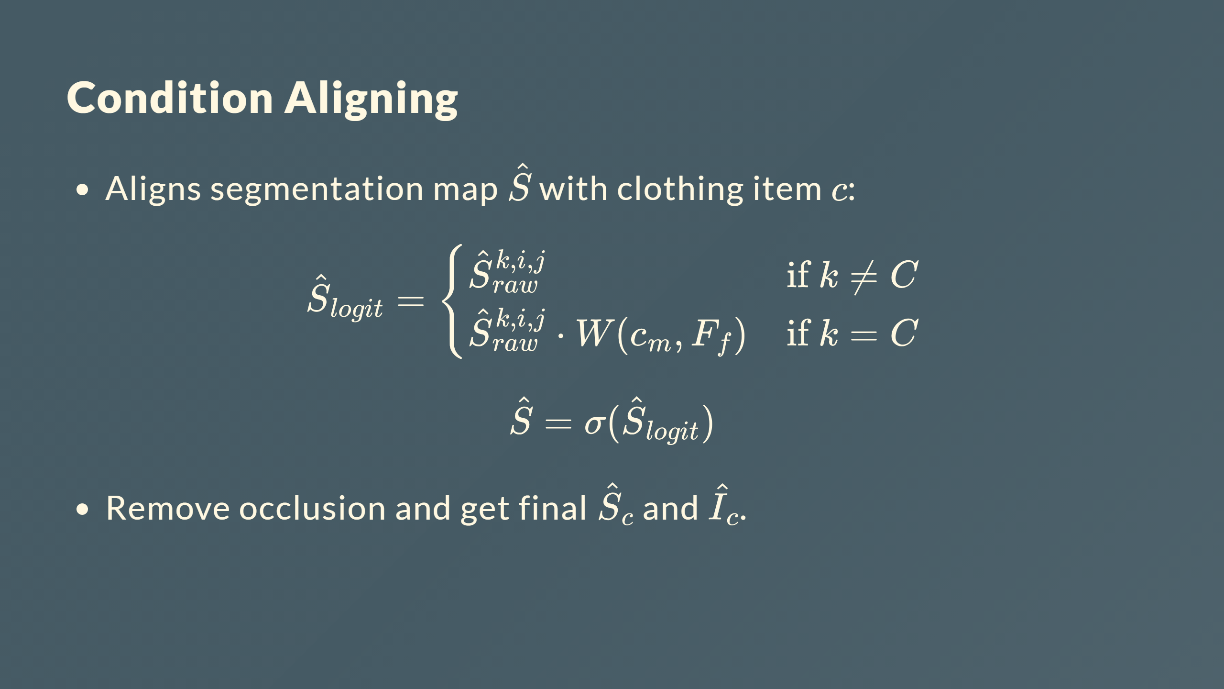

Slide 20
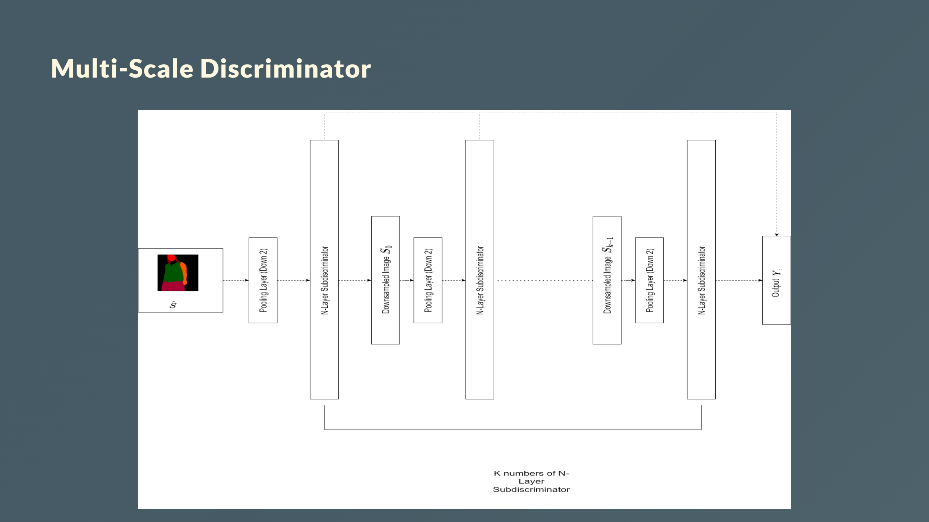
Notes:
- Each $D_i$ operates on downsampled $S_i$ - Concatenates $\hat{Y}_i$ outputs into final $Y$ - Captures multi-scale information - $k$ of $N$-layer sub-discriminators $D_i$ --- <div style="color: white; font-size: 30px; margin-top: 150px; margin-left:0px"> <b>Multi-Scale Discriminator</b> - Each $D_i$ operates on downsampled $S_i$ - Concatenates $\hat{Y}_i$ outputs into final $Y$ - Captures multi-scale information - $k$ of $N$-layer sub-discriminators $D_i$ </div>

Slide 21
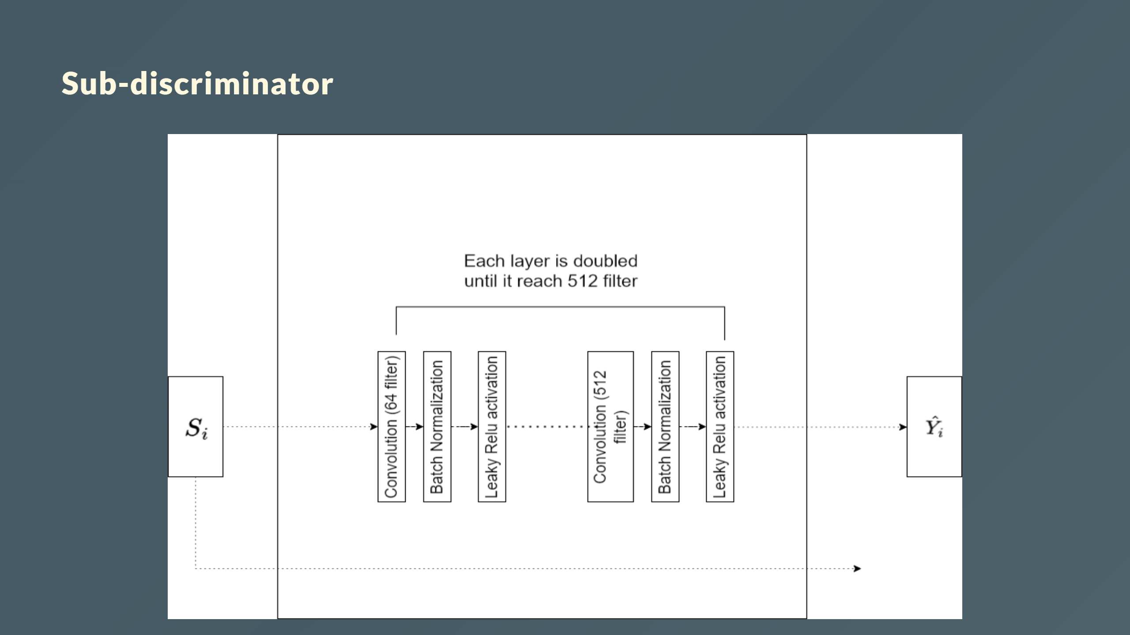
Notes:
- Input: Downsampled segmentation map $S_i$ - Output: Prediction map $\hat{Y}_i$ - Consits of $N$ convolutional layers --- <div style="color: white; font-size: 30px; margin-top: 150px; margin-left:0px"> <b>Sub-discriminator </b> - Input: Downsampled segmentation map $S_i$ - Output: Prediction map $\hat{Y}_i$ - Consits of $N$ convolutional layers </div>

Slide 22
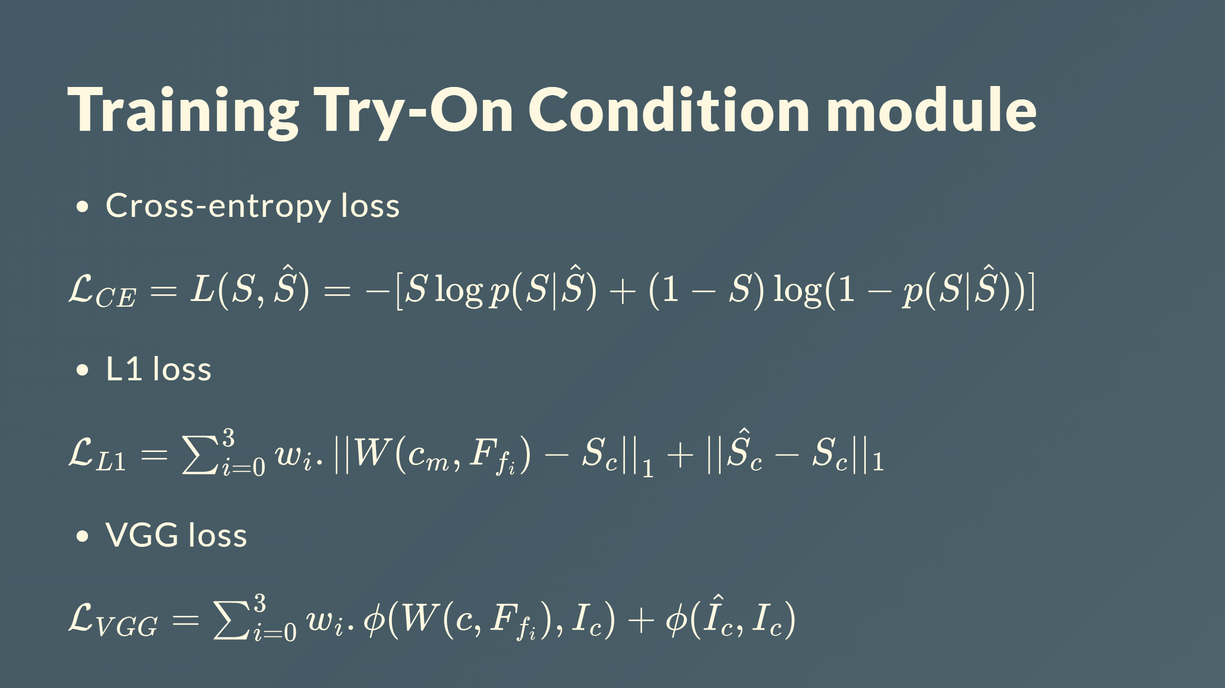

Slide 23
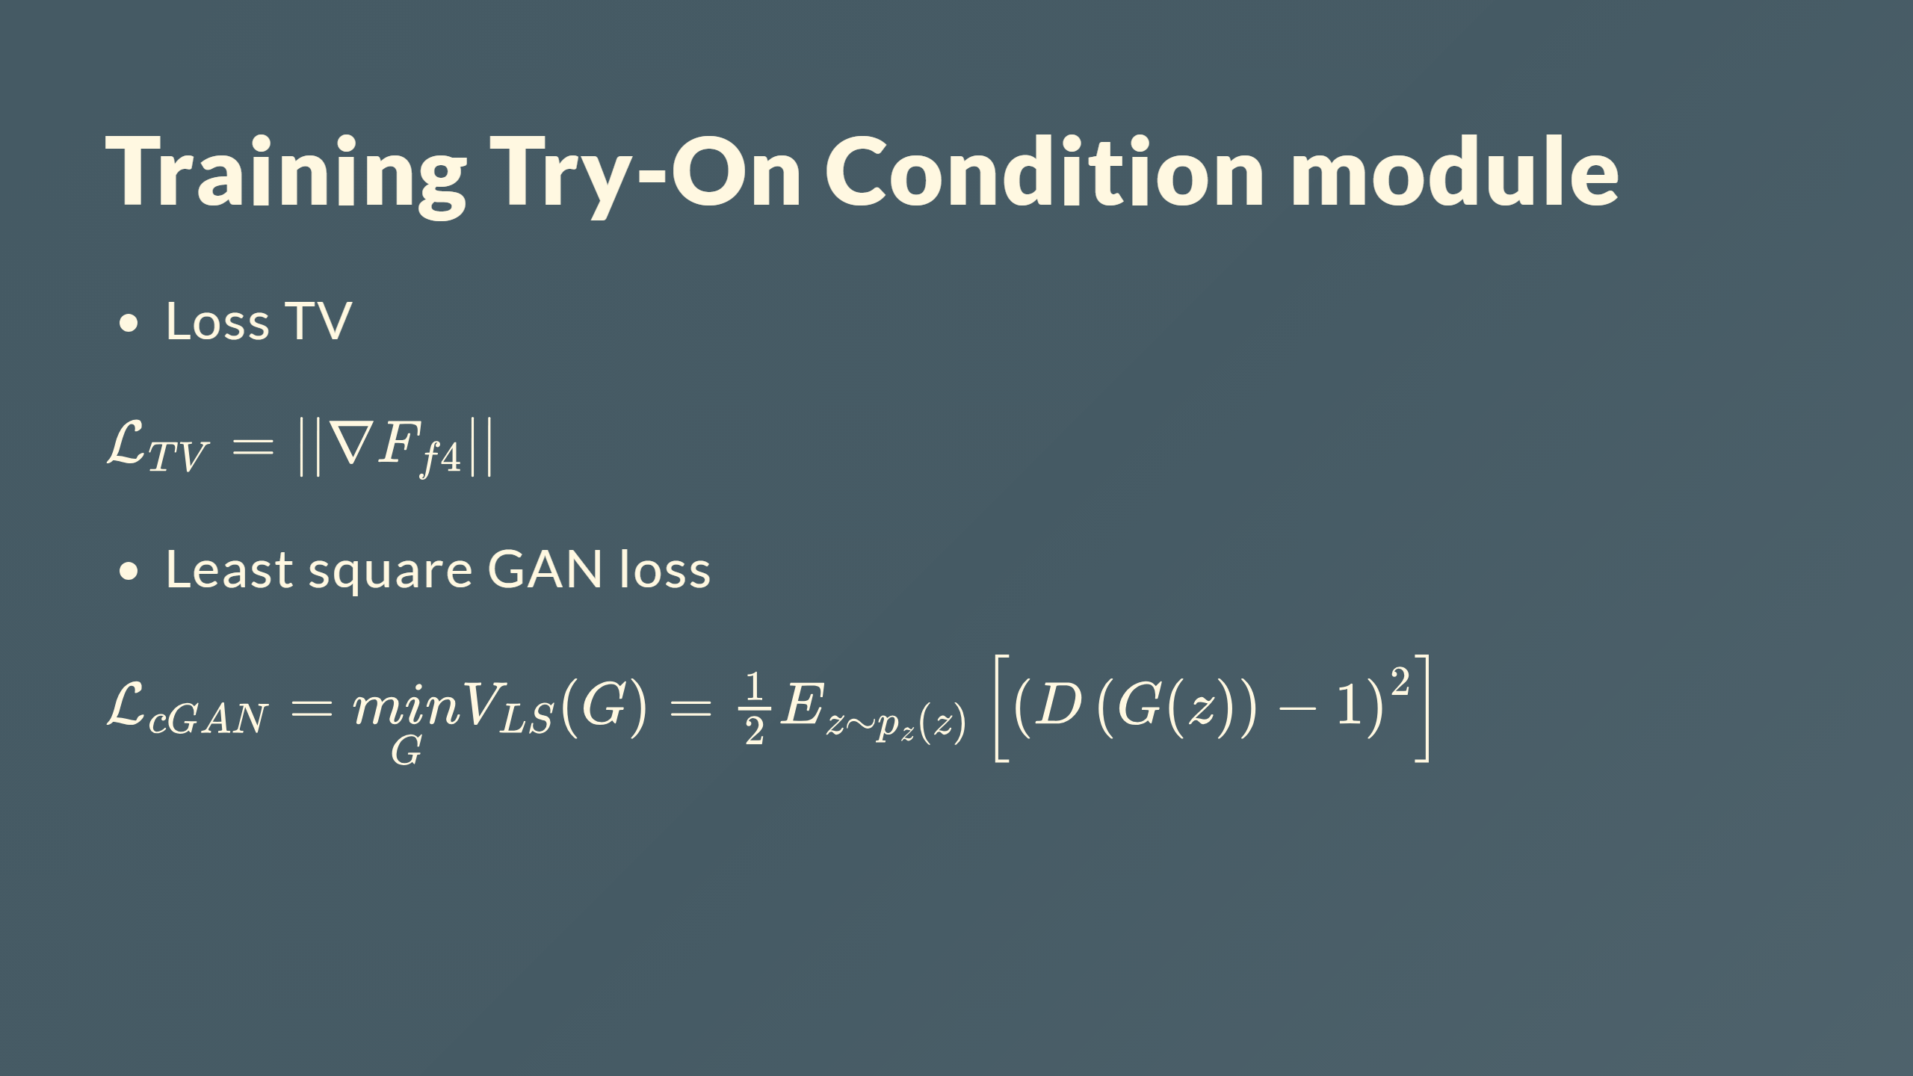

Slide 24
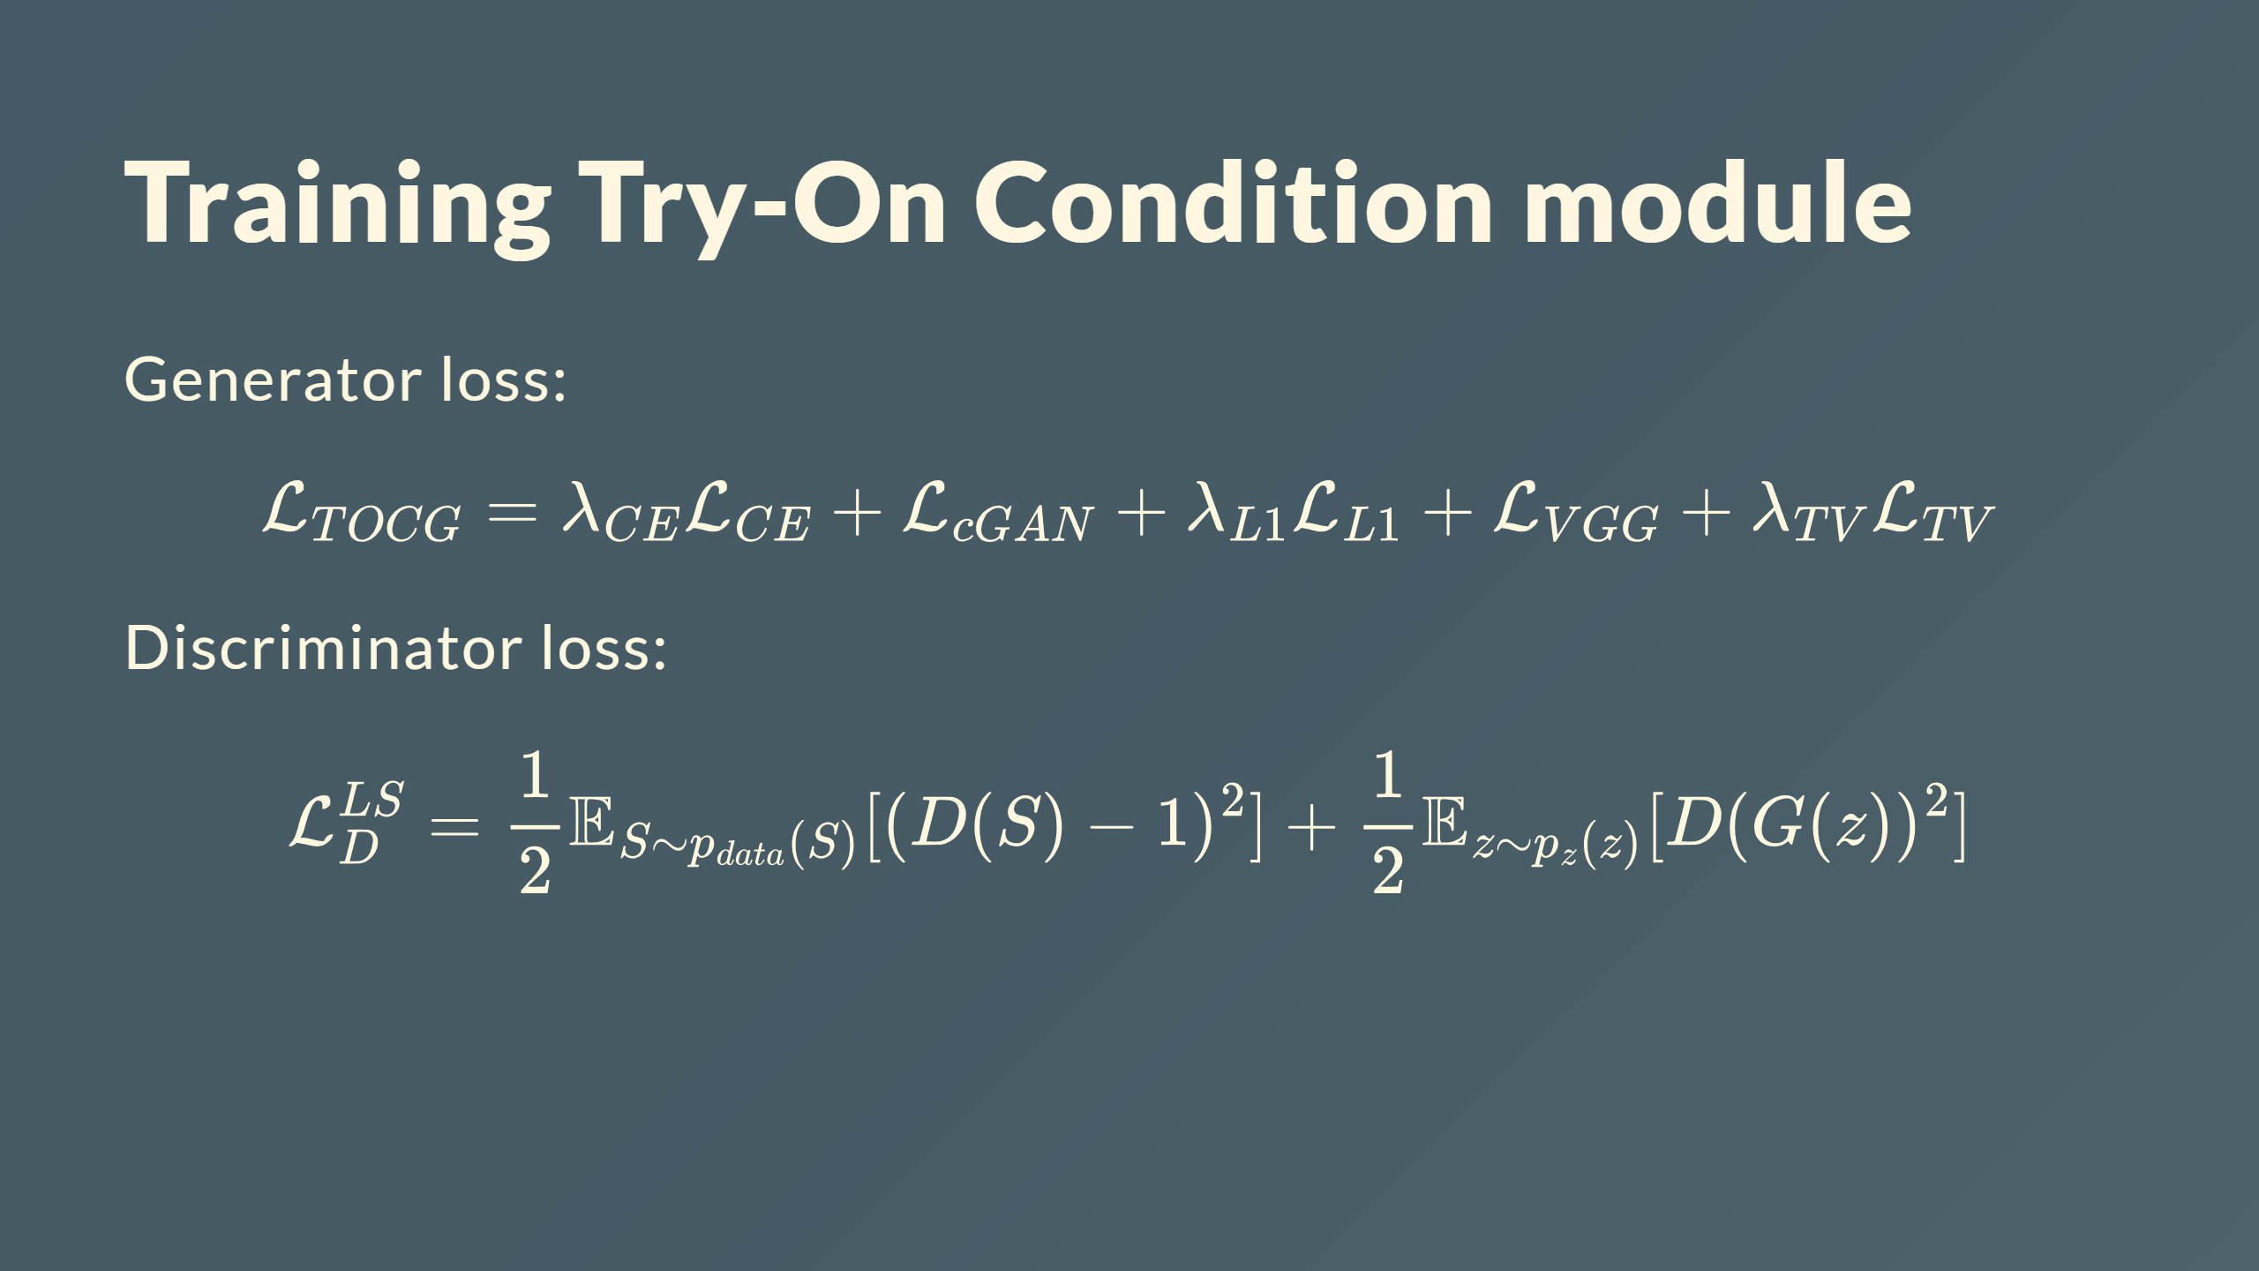

Slide 25
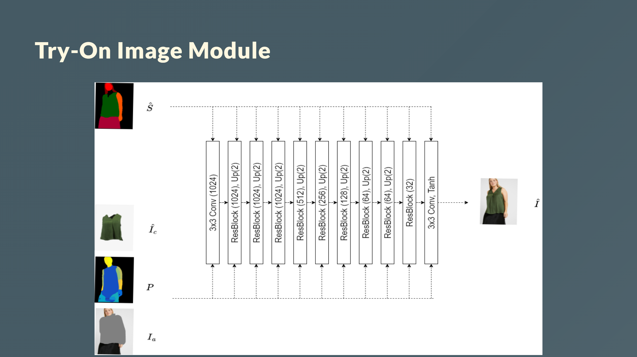
Notes:
# Try-On Image Module Input: - Clothing-agnostic image $I_a$, - Warped clothing image $\hat{I}_c$, - Denpose $P$, Segmentation map $\hat{S}$ Output - Final try-on image $\hat{I}$ Generator architecture - 2 $3\times3$ convolutions - SPADE residual blocks - Leverage $\hat{S}$ to guide image generation - Using SPADE normalization ---

Slide 26
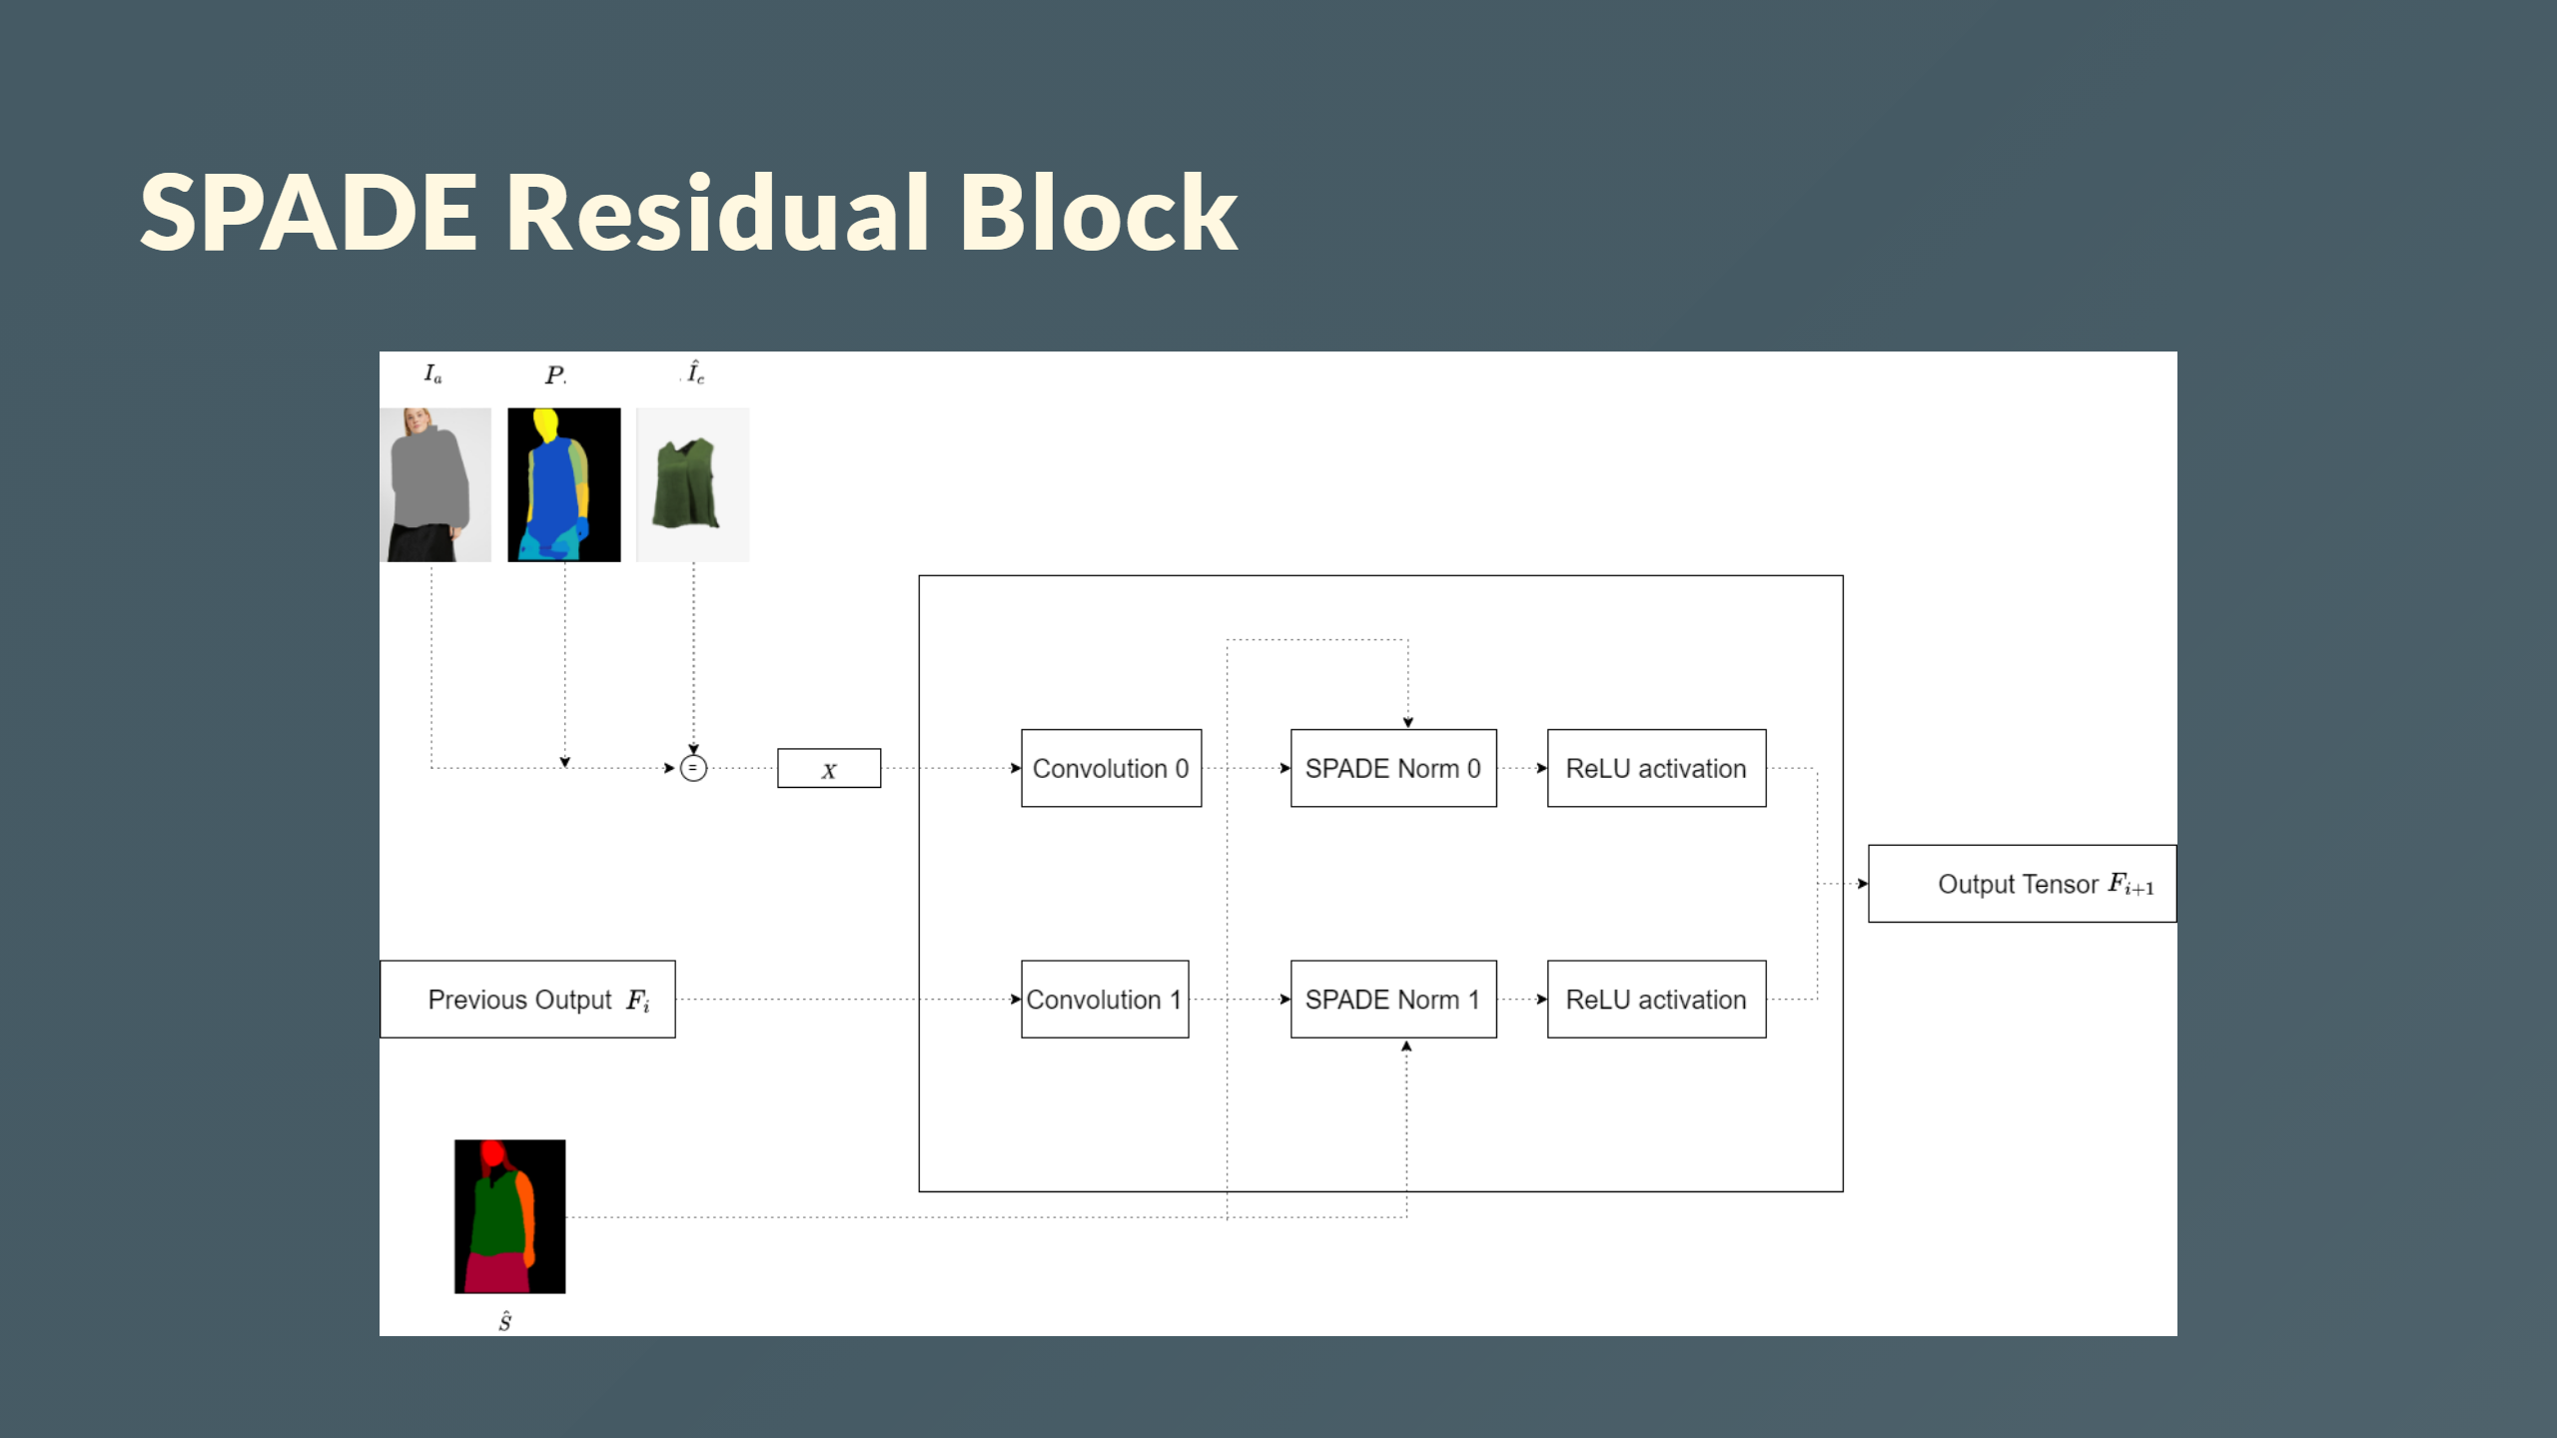
Notes:
<div style="color: white; font-size: 30px; margin-top: 30px; text-align: center; "> <b>Spade Residual Block</b> </div>

Slide 27
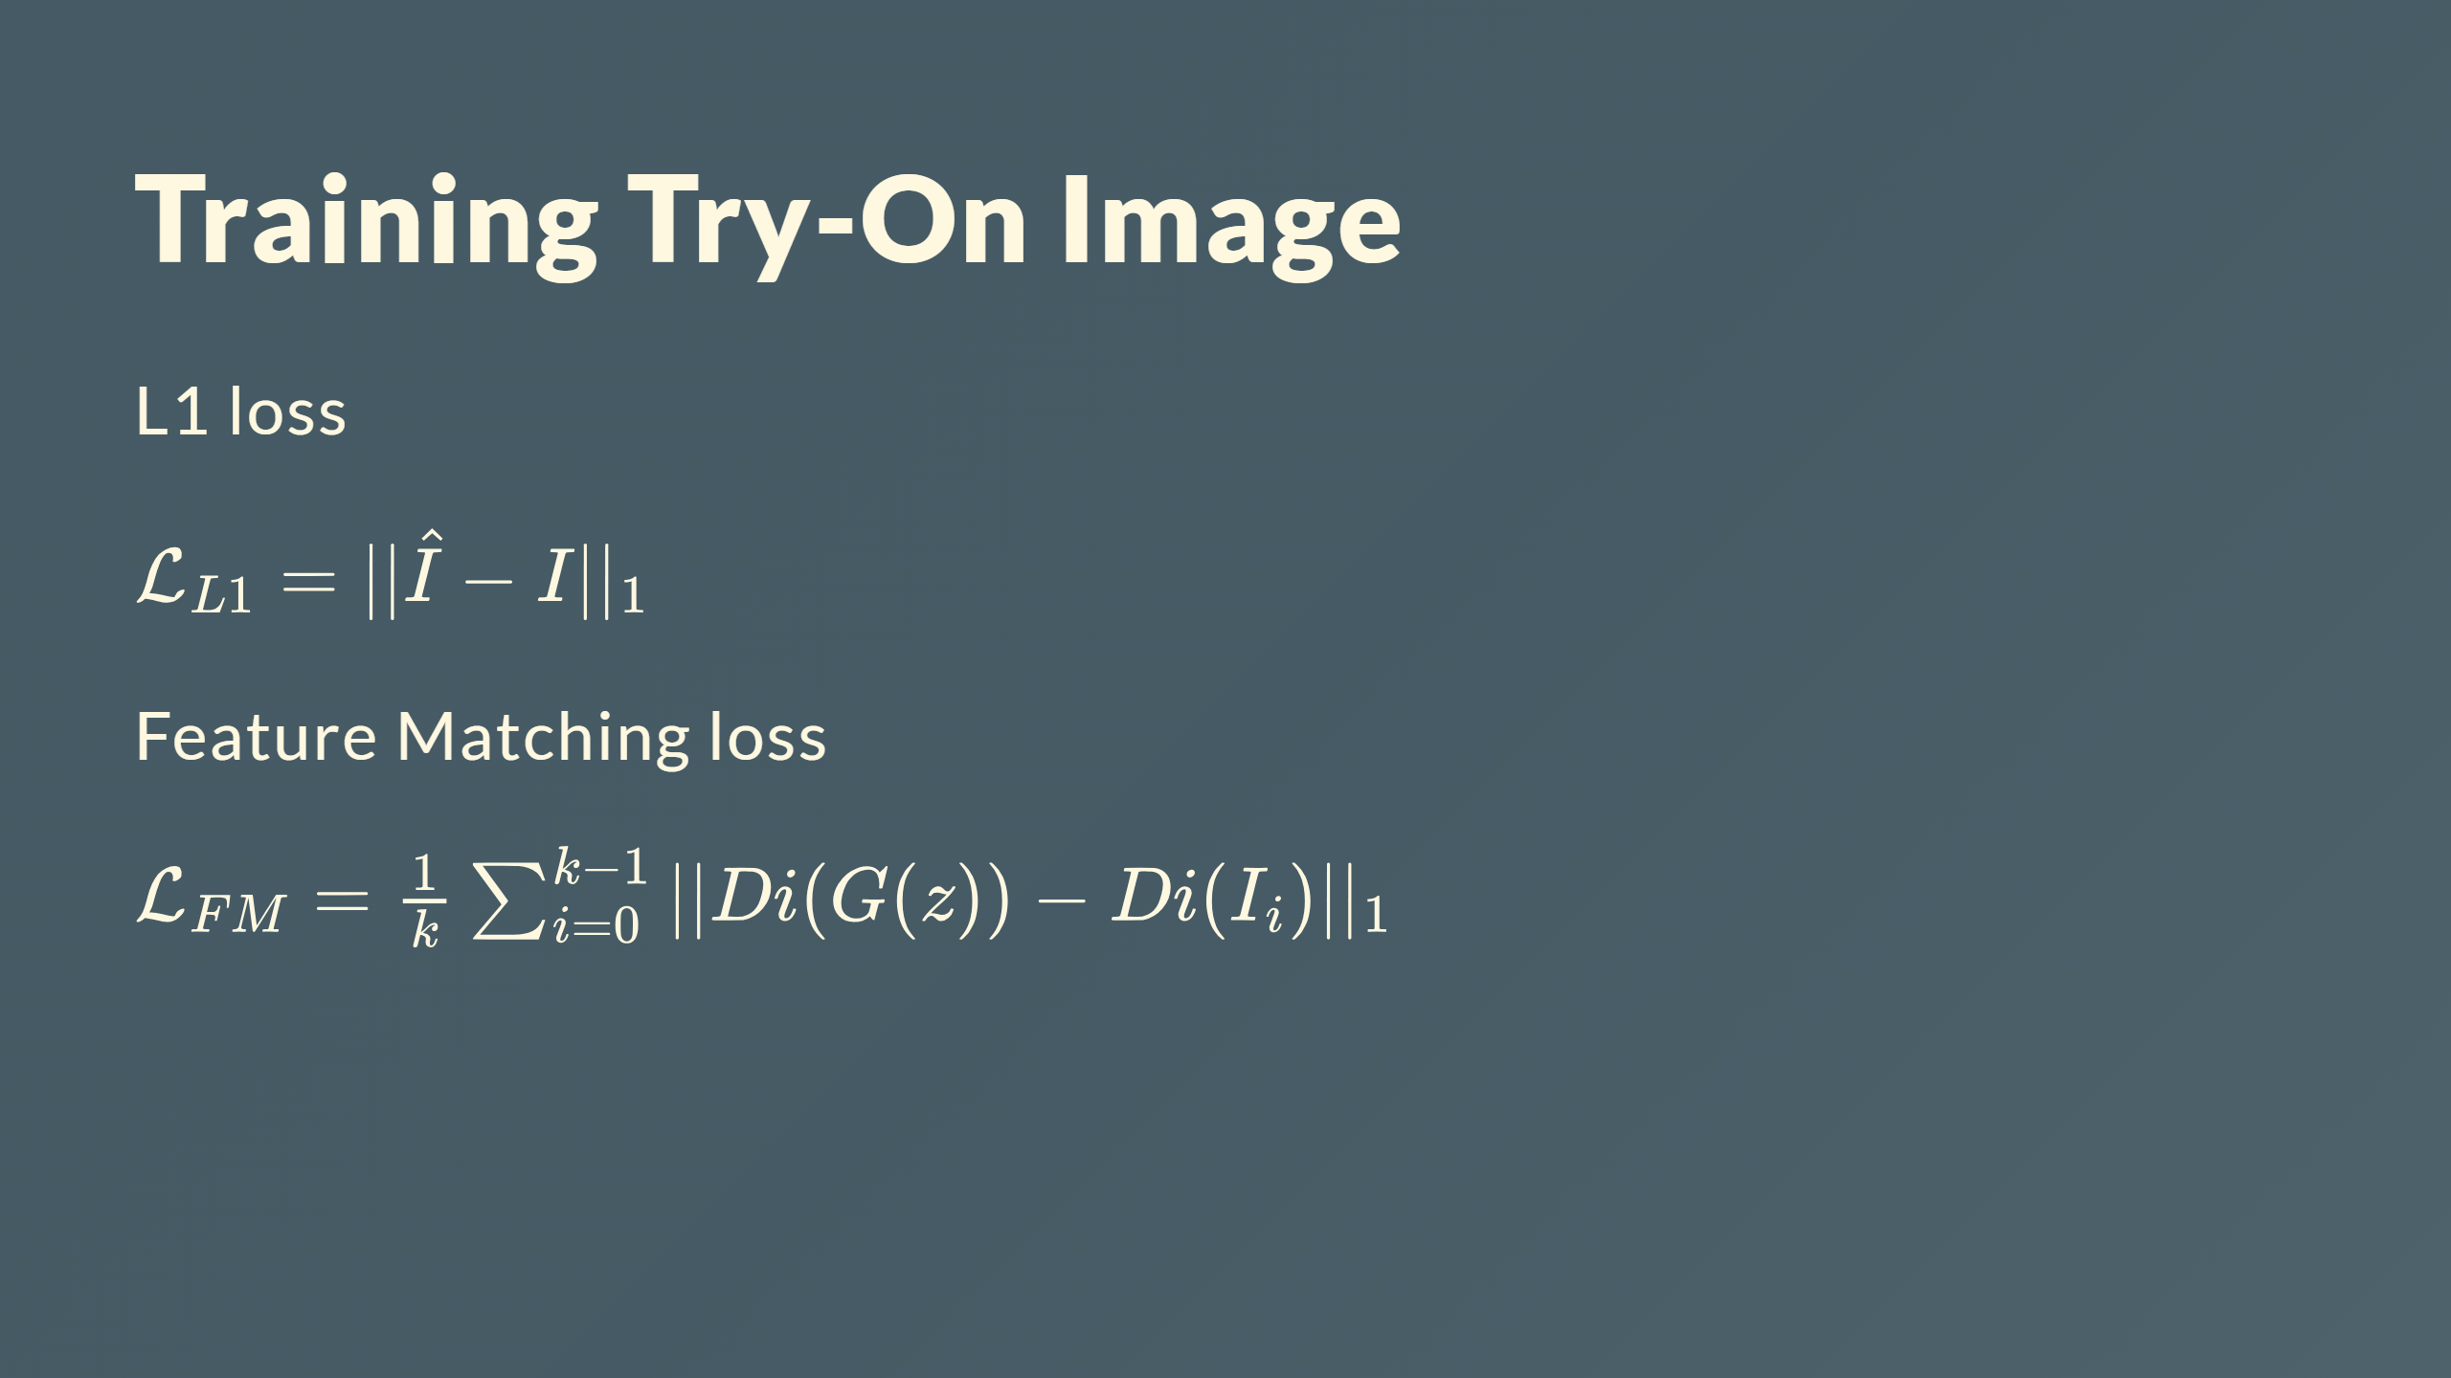

Slide 28
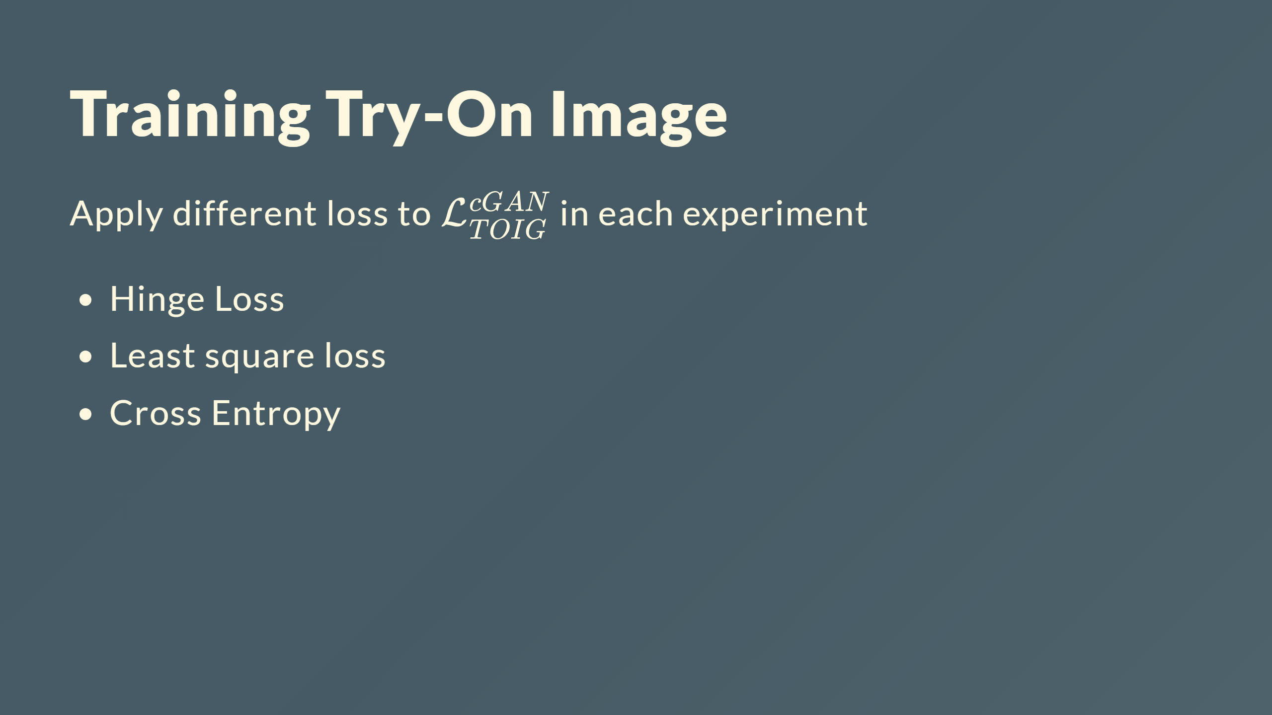

Slide 29
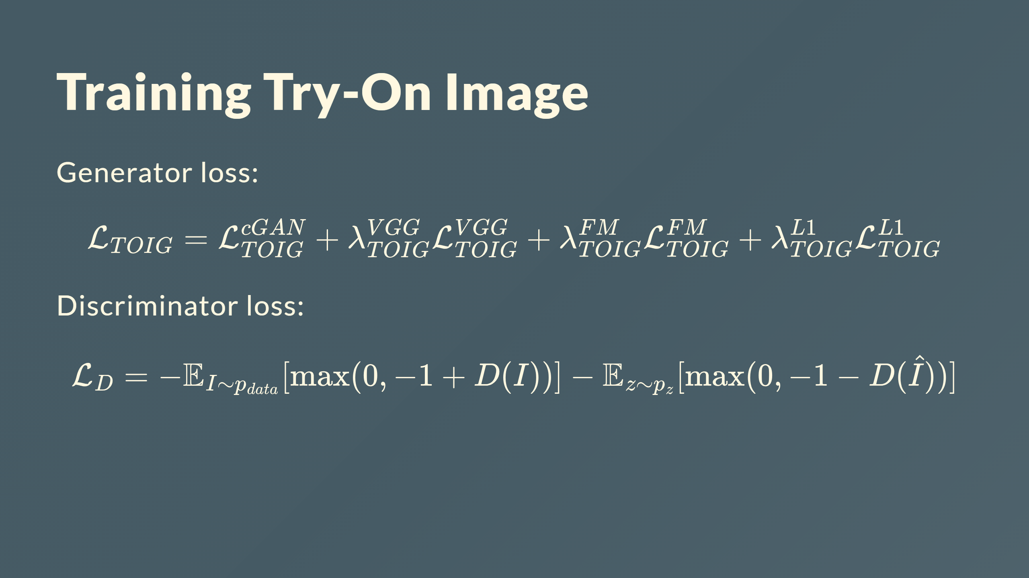

Slide 30
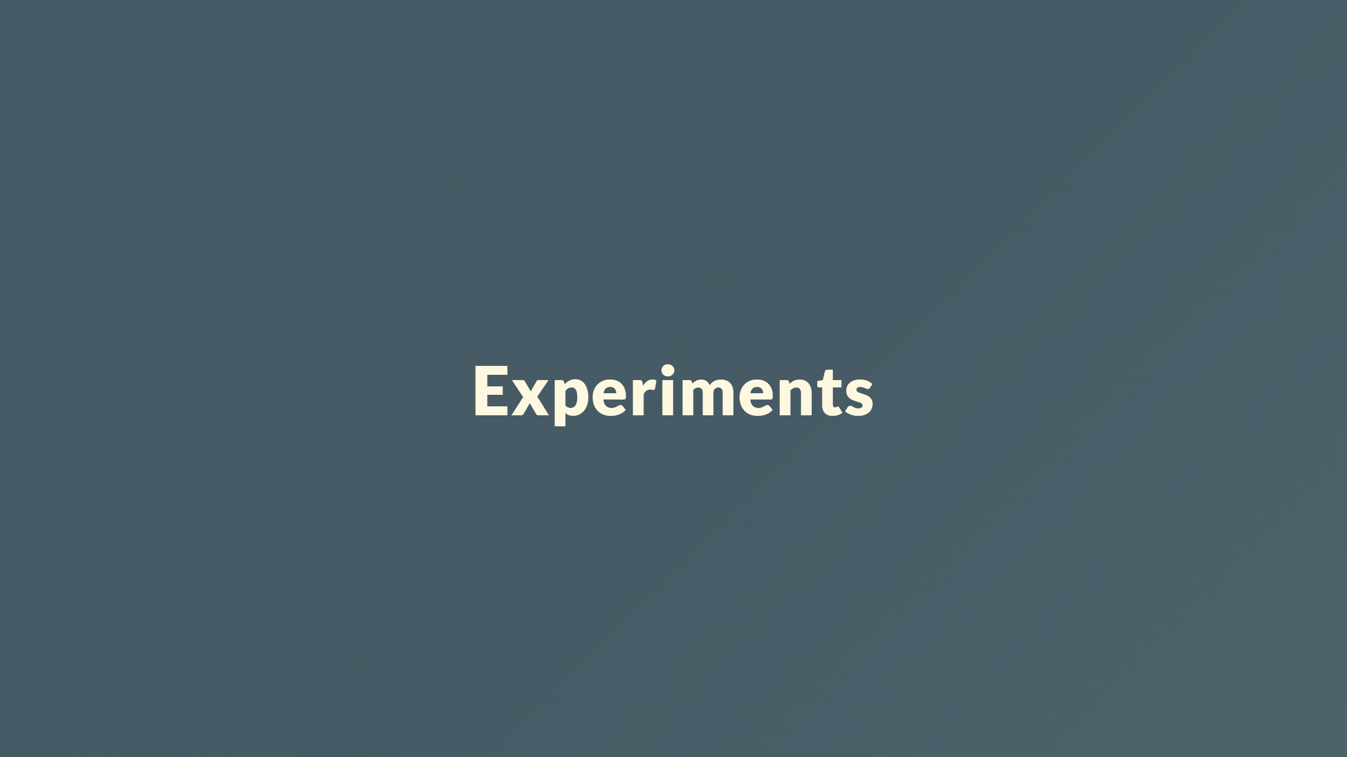

Slide 31
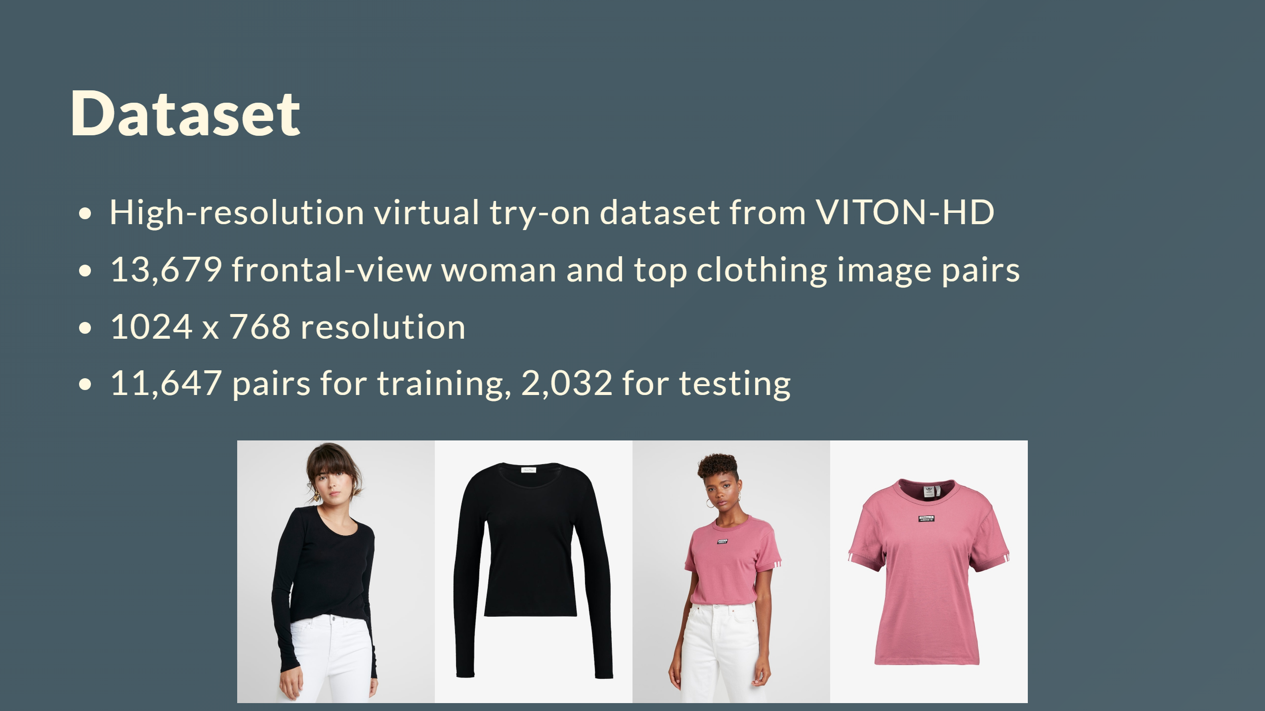

Slide 32
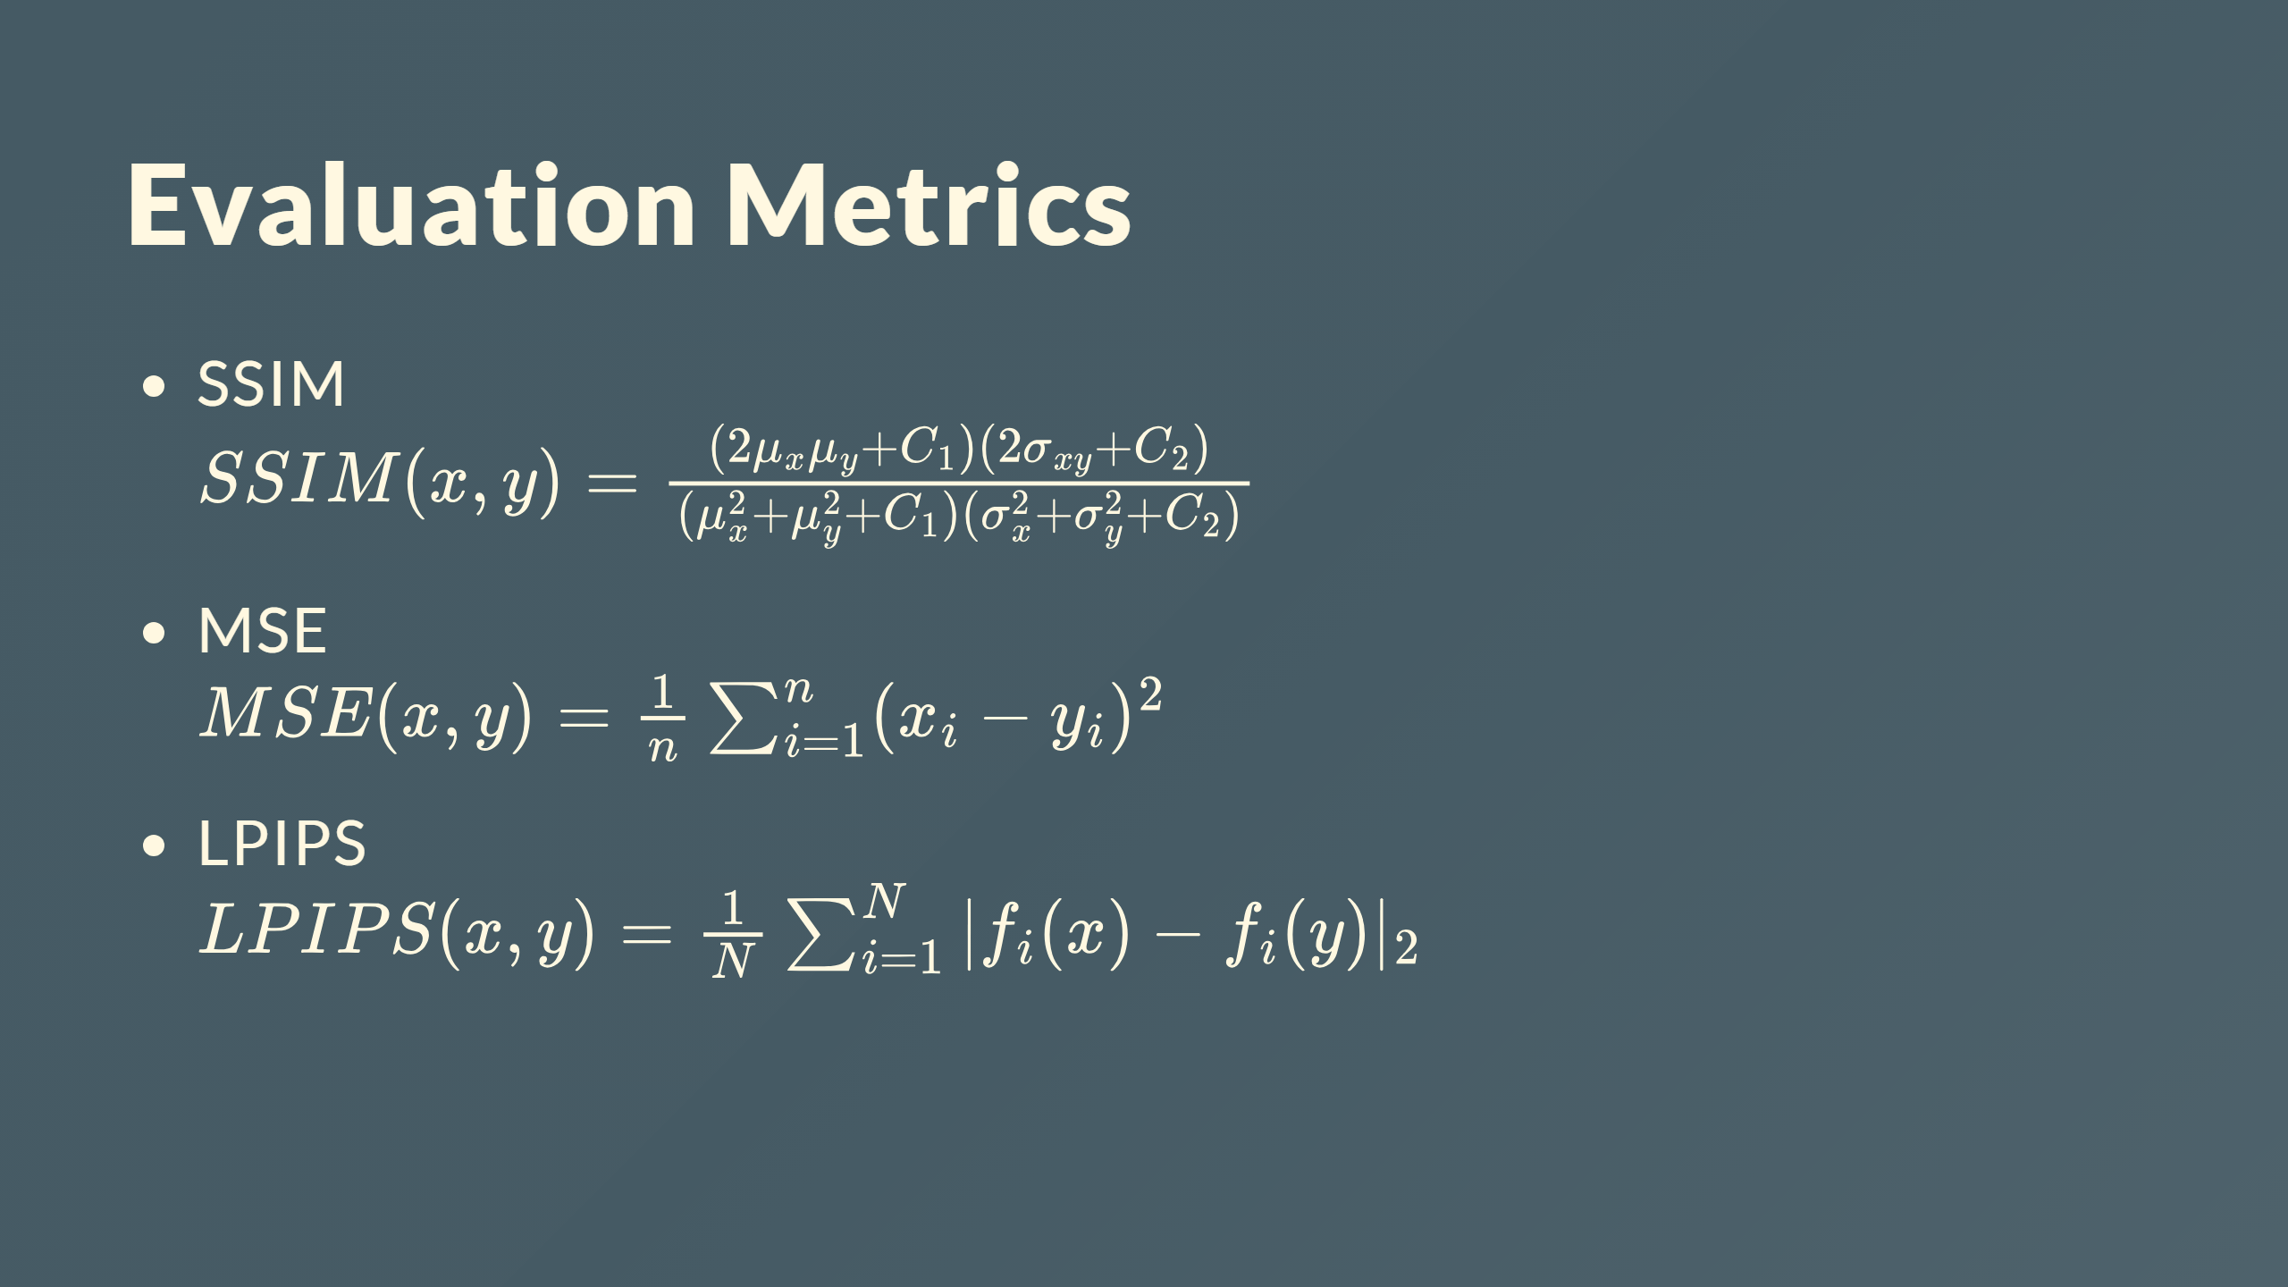

Slide 33
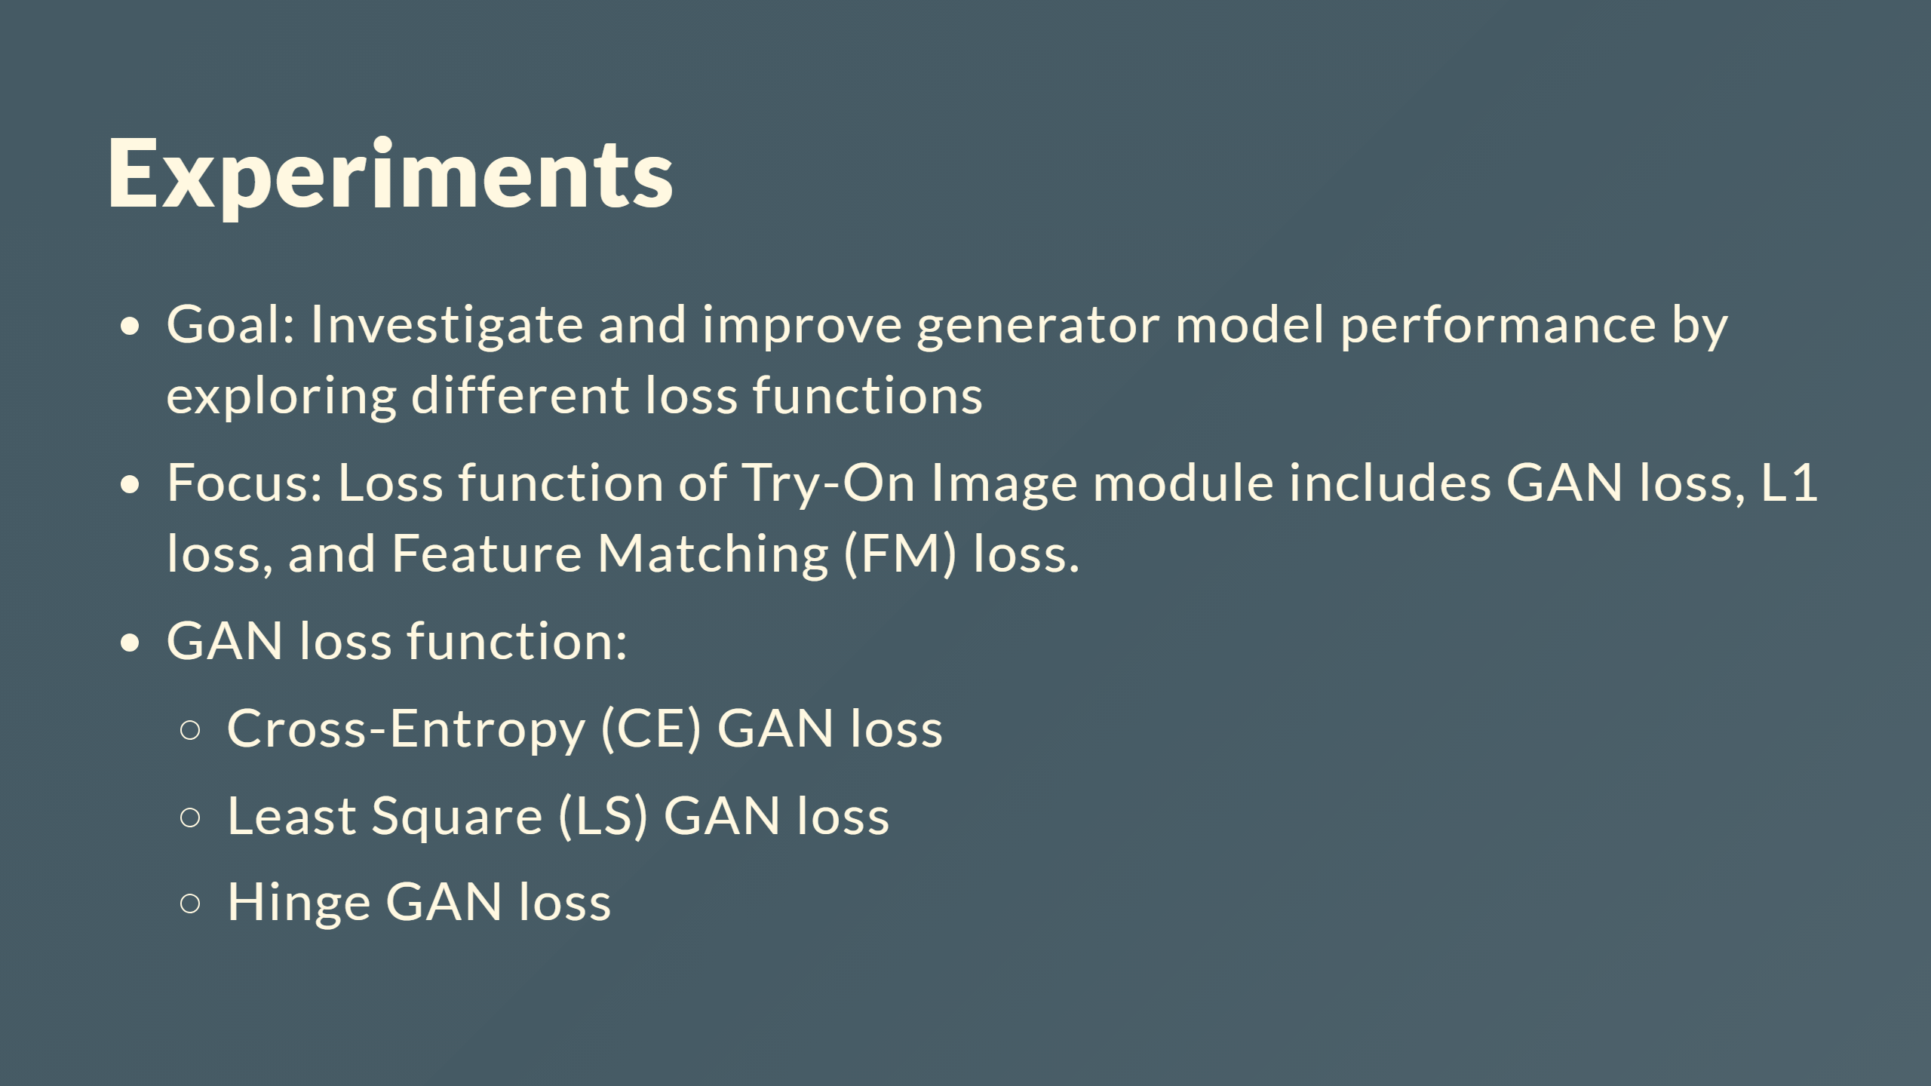

Slide 34
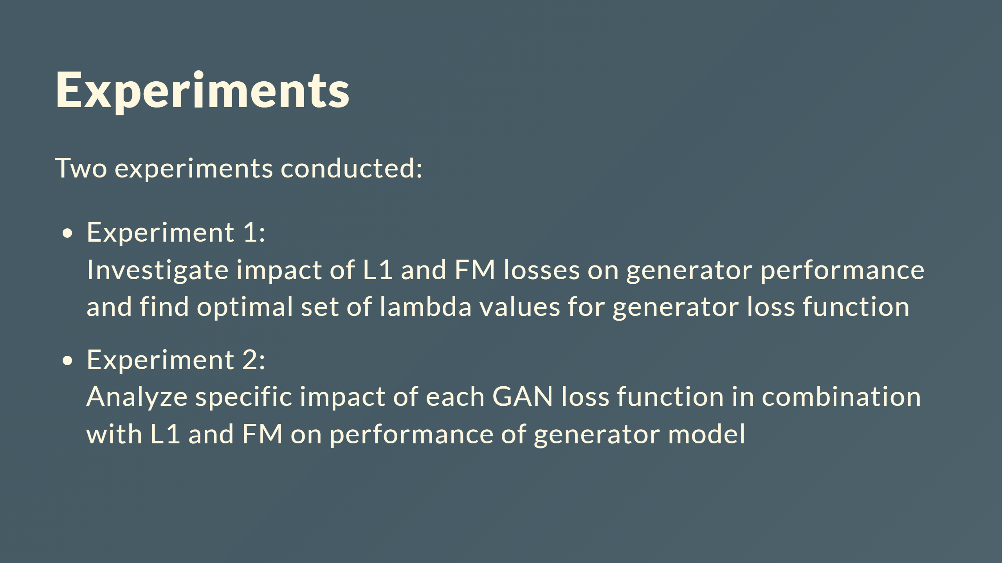

Slide 35
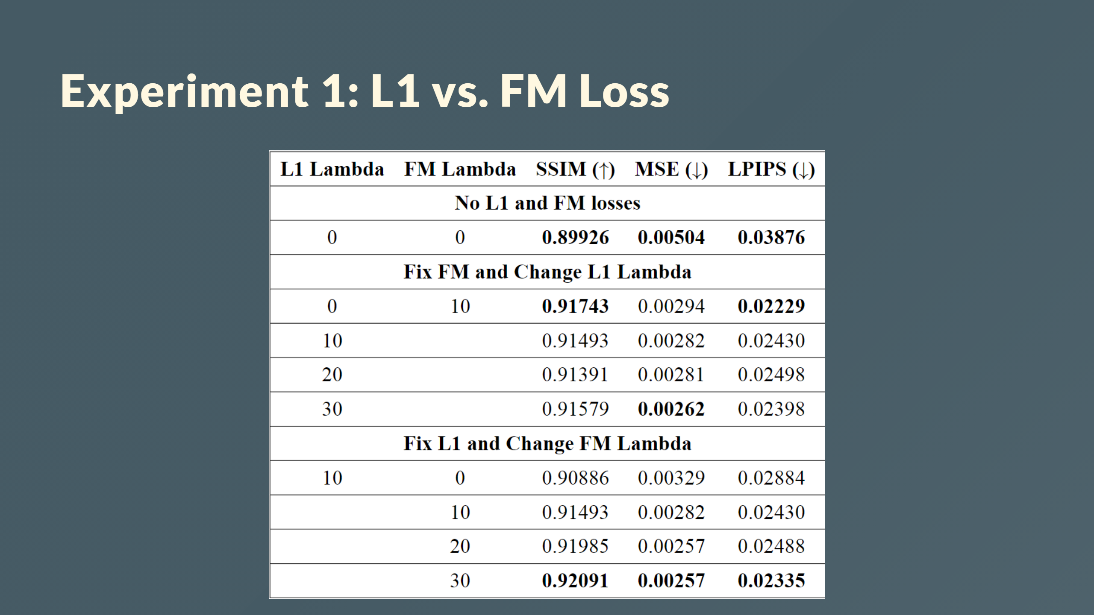

Slide 36
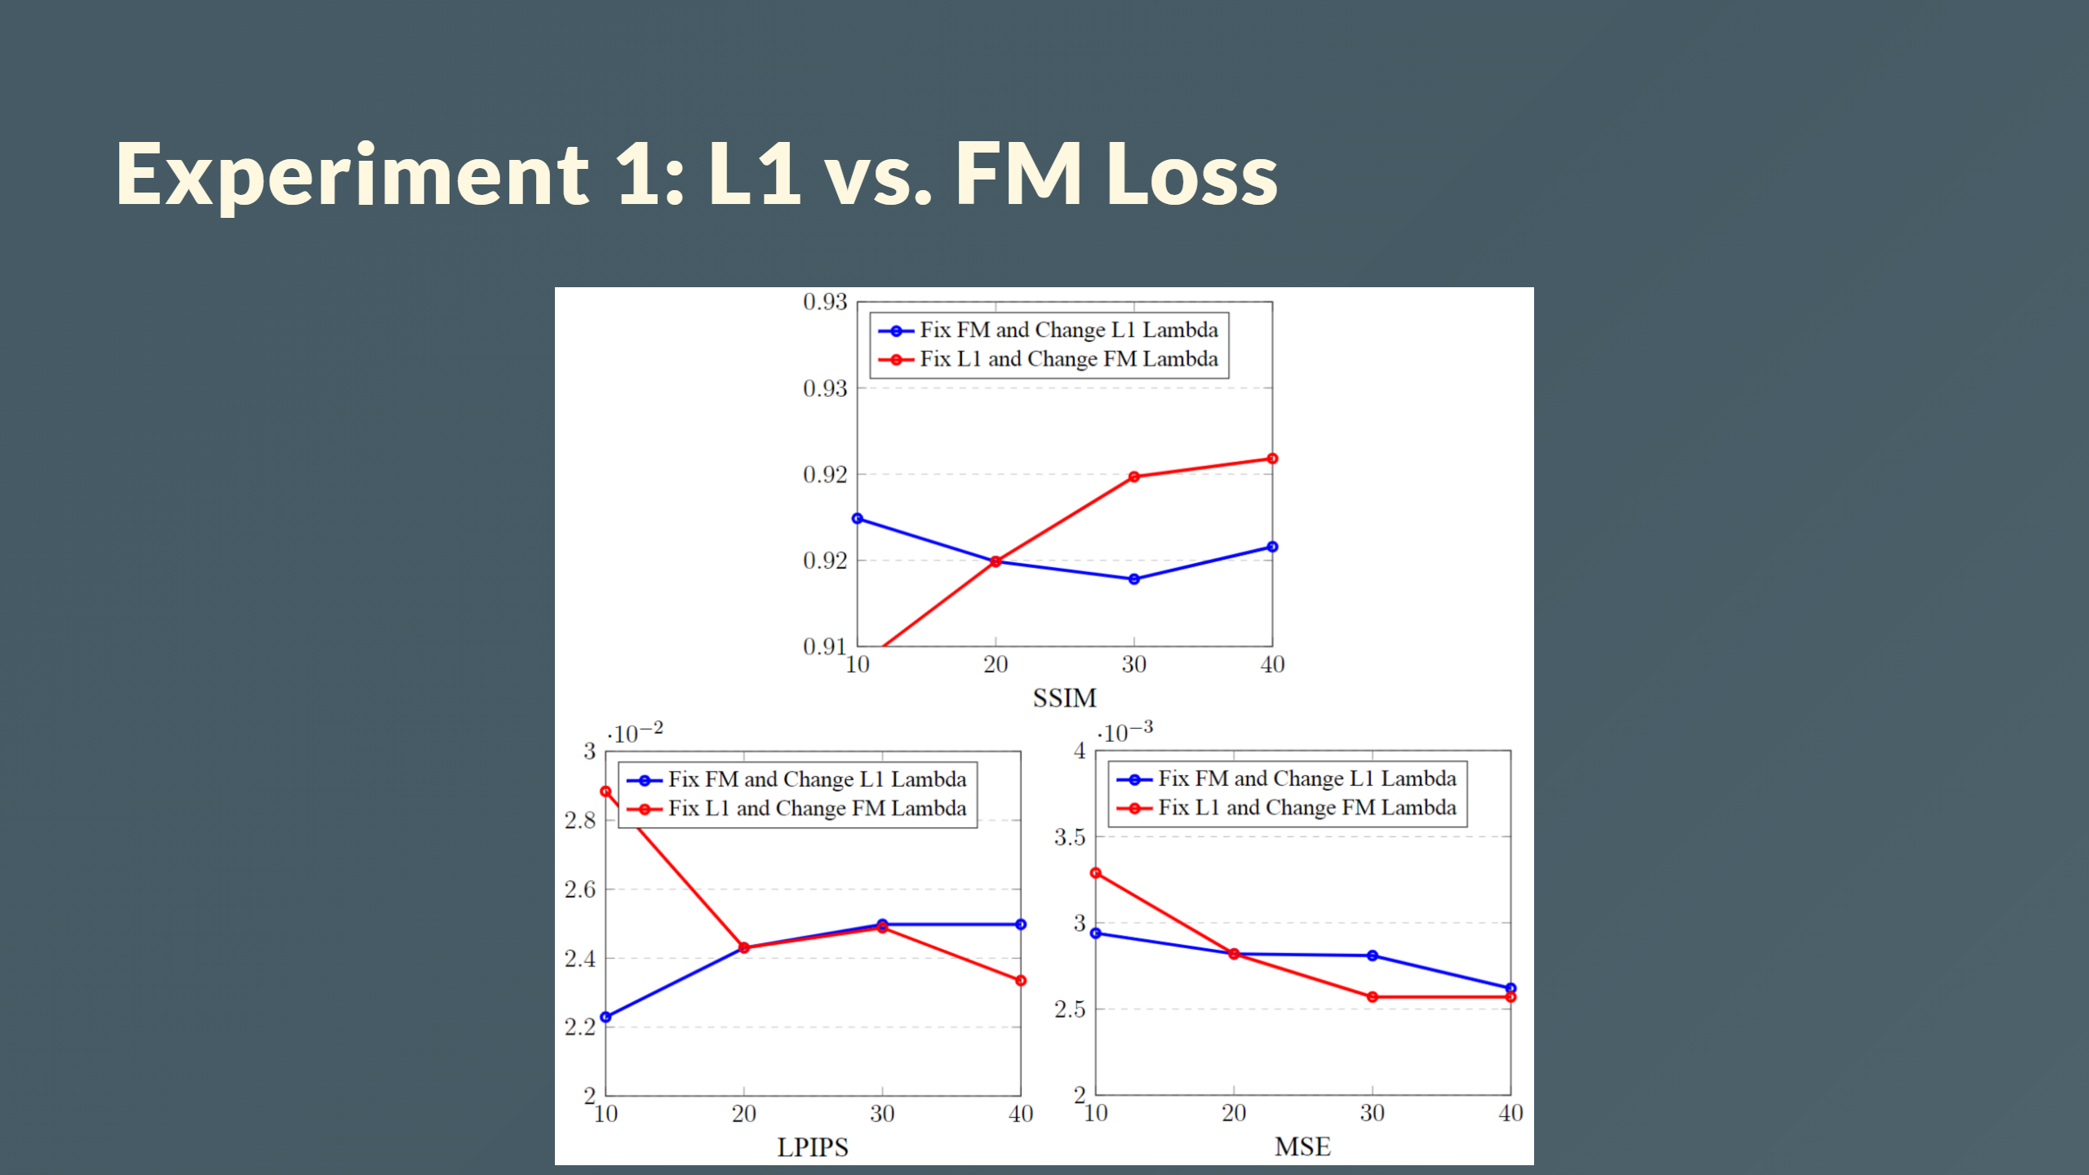

Slide 37
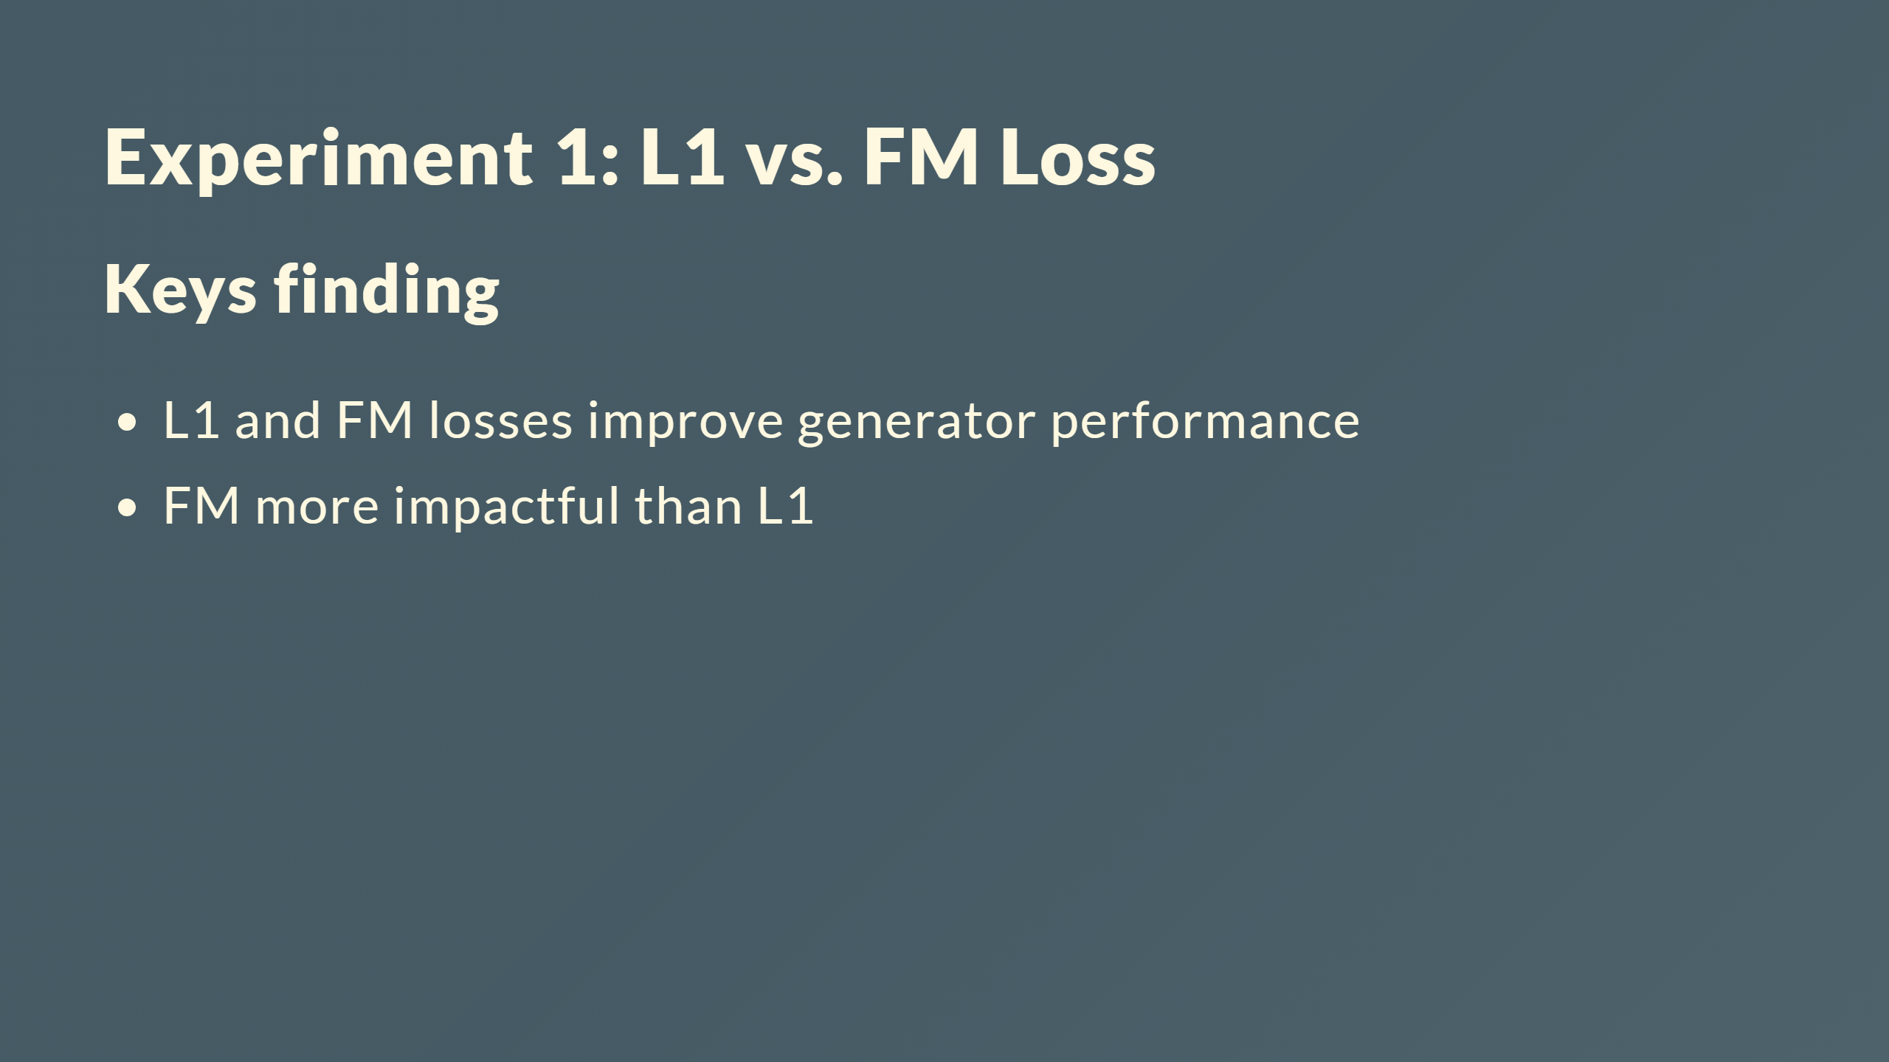

Slide 38
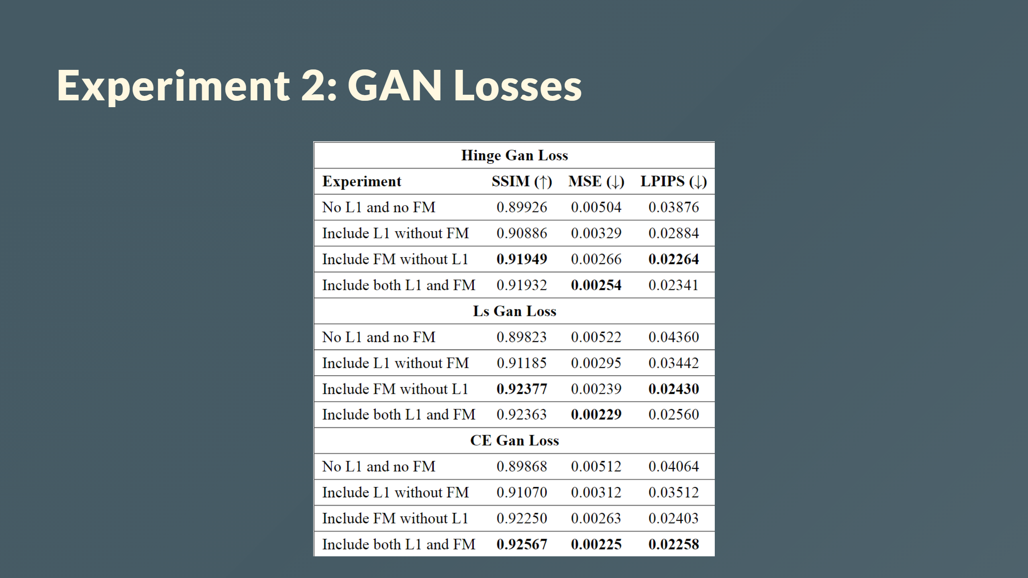

Slide 39
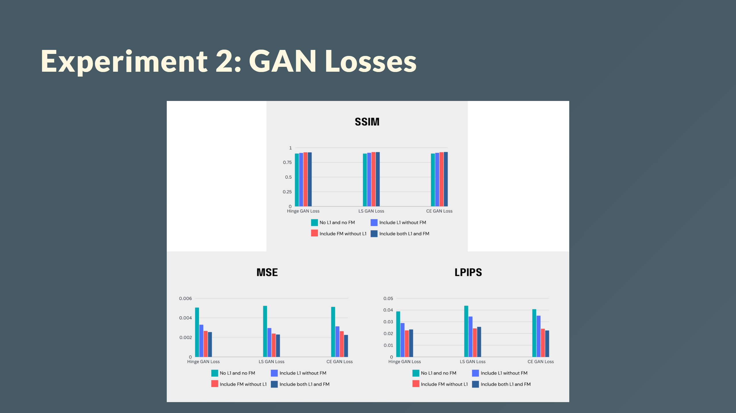

Slide 40
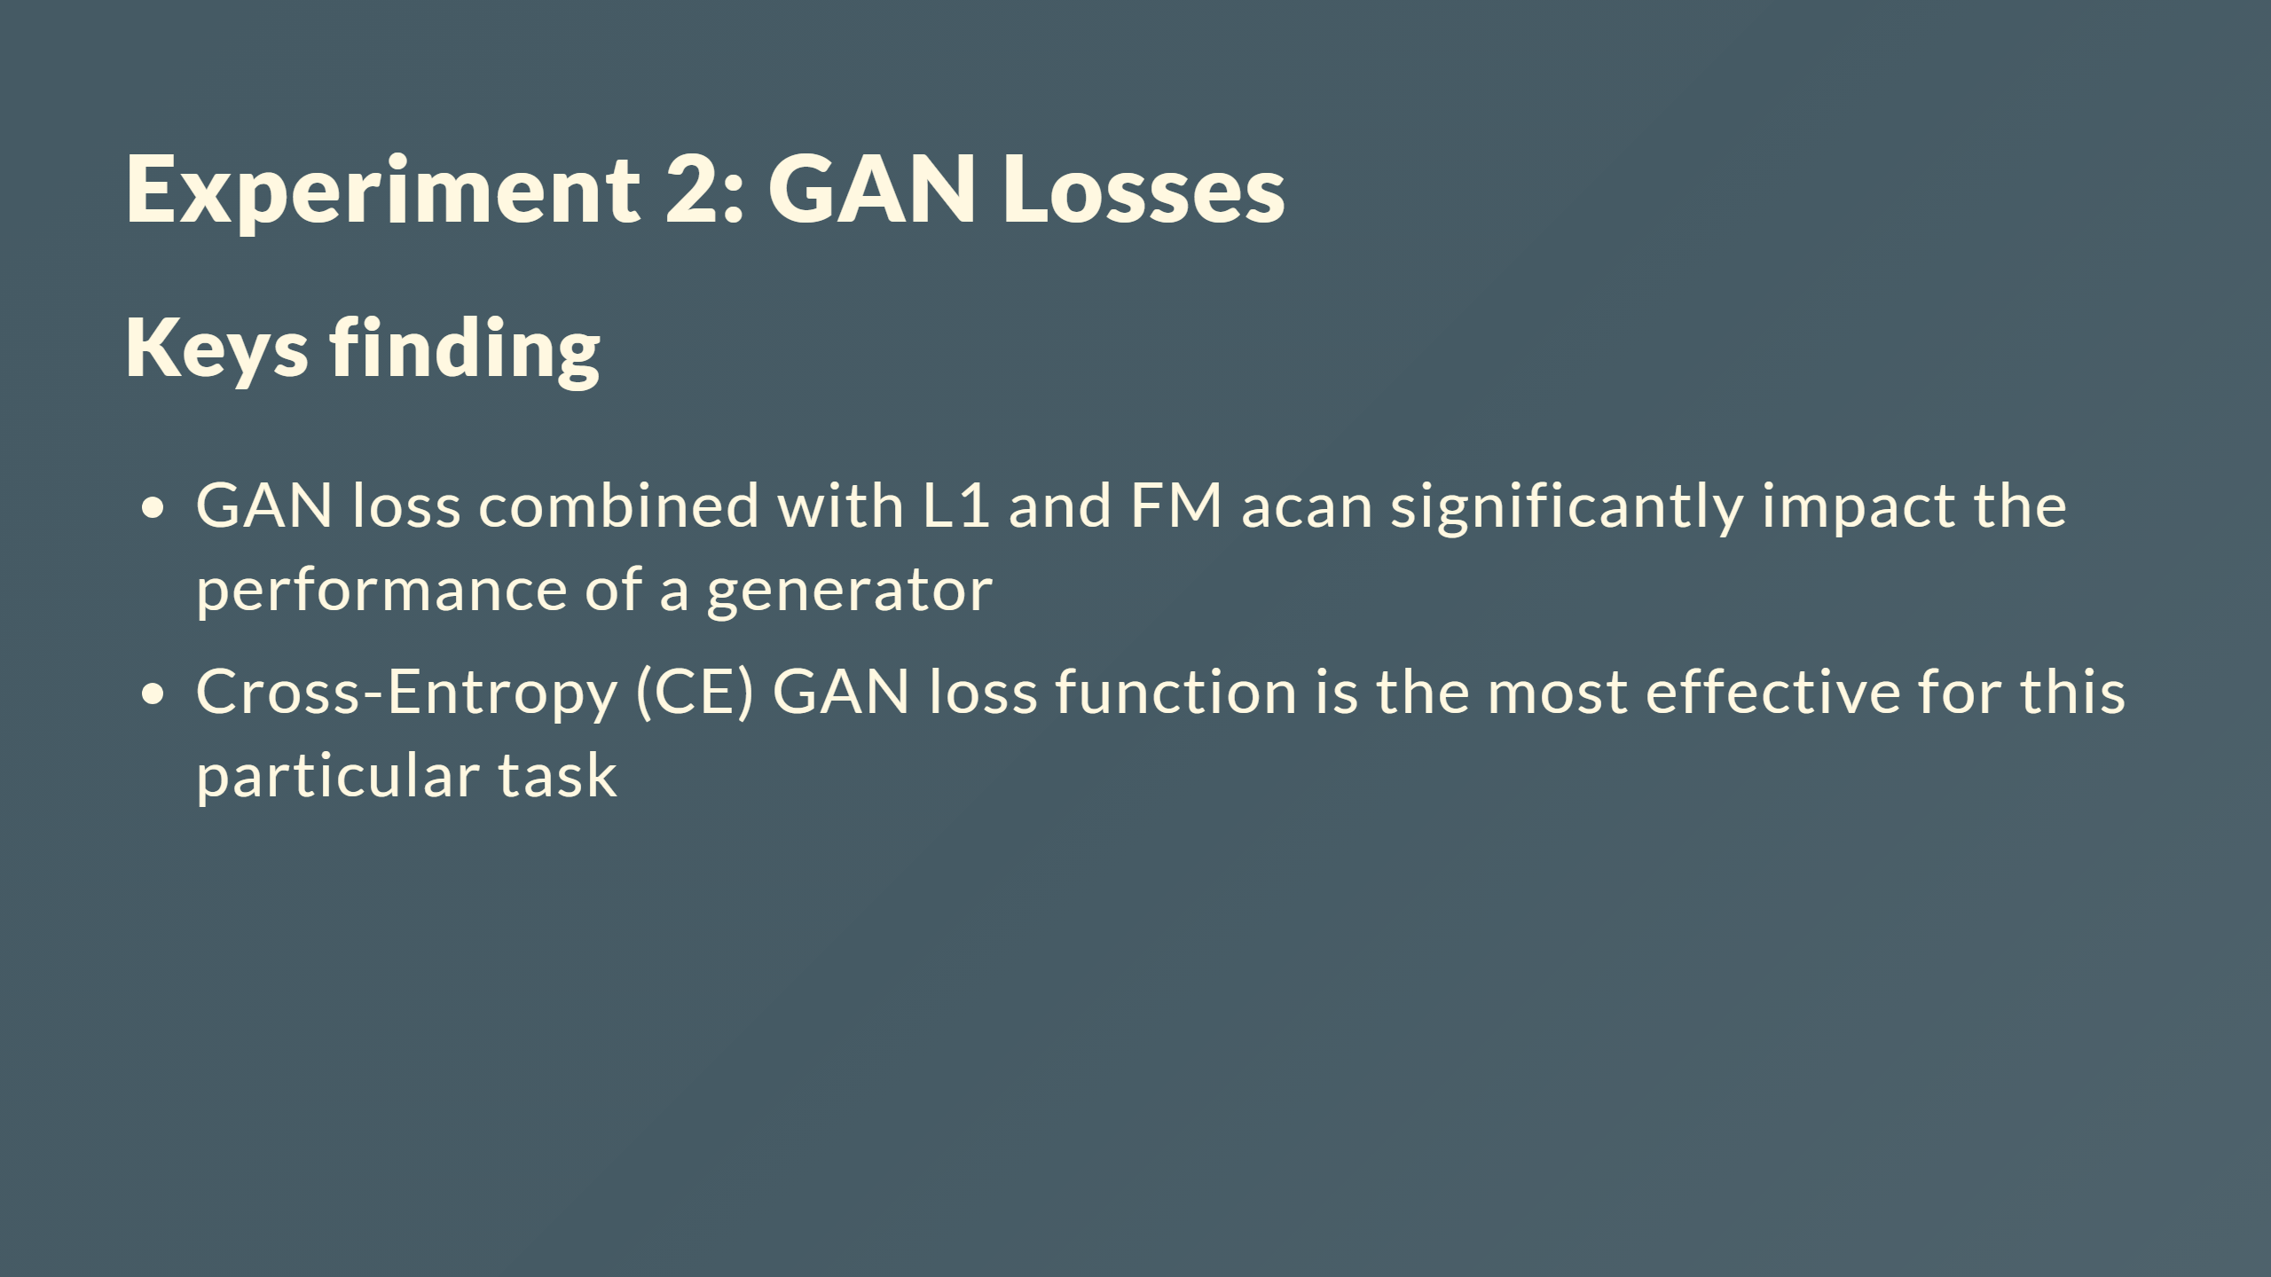

Slide 41
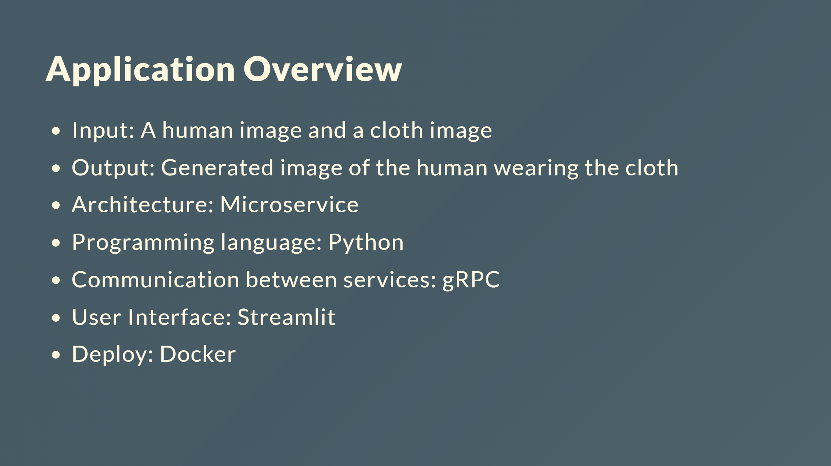

Slide 42
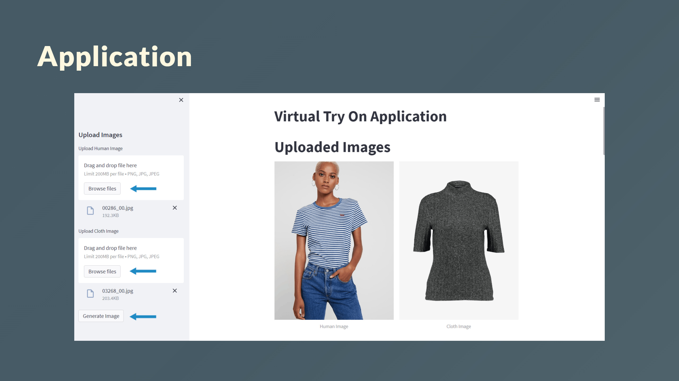

Slide 43
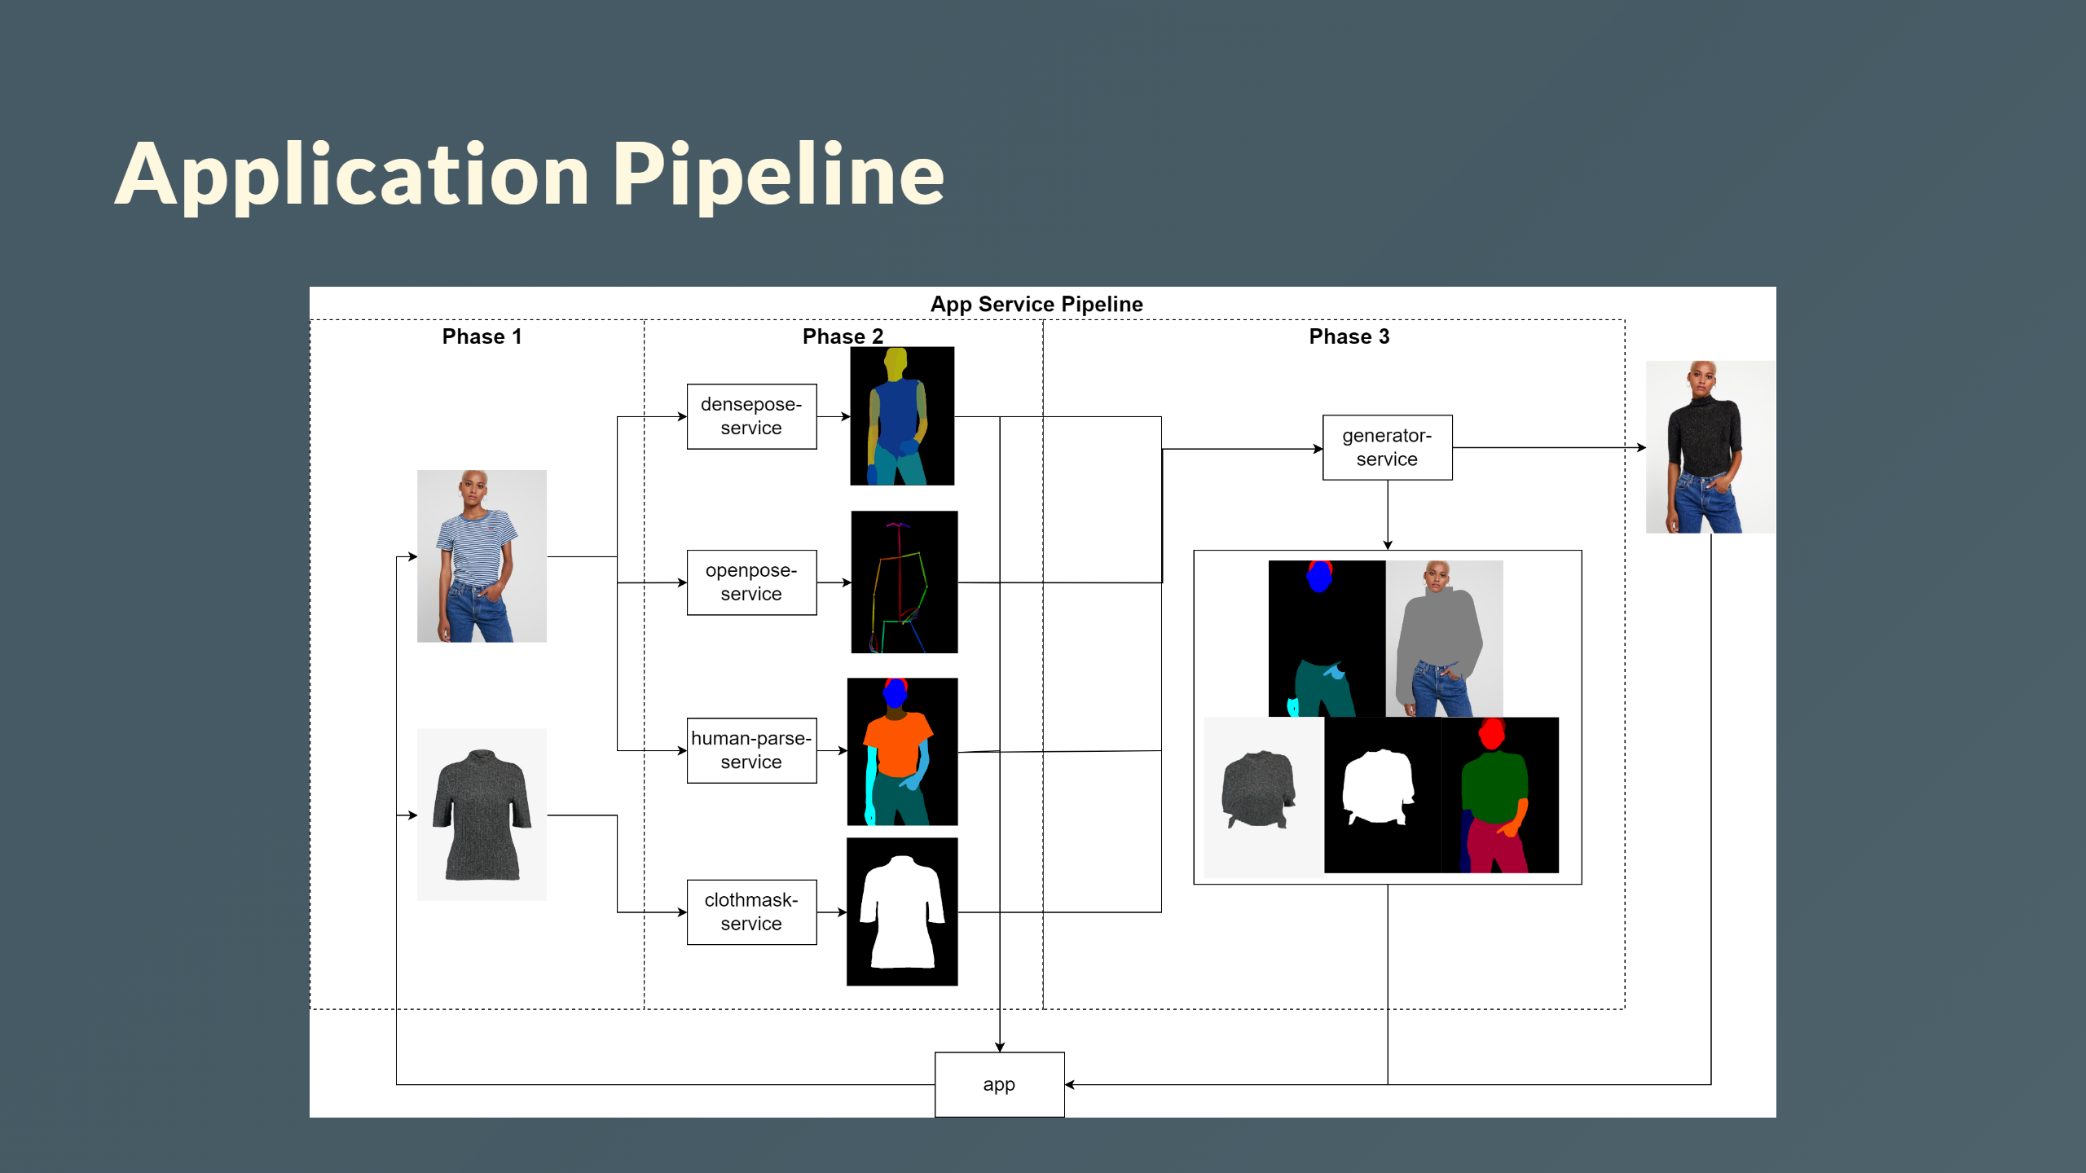

Slide 44
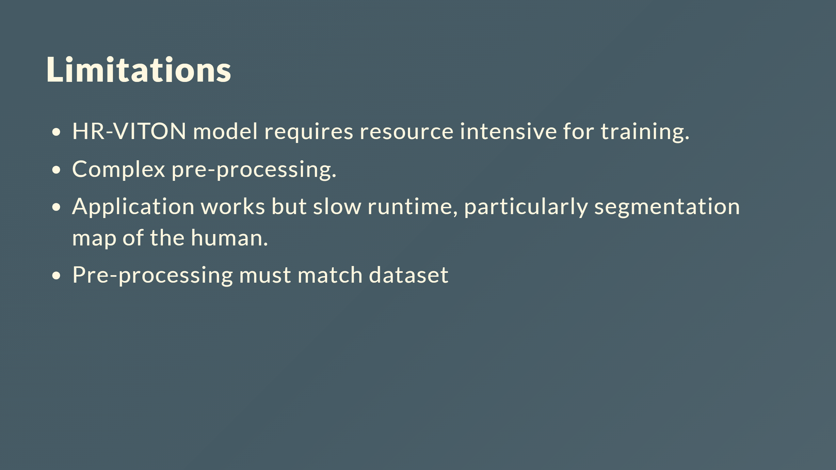
Notes:
## Discussion ---

Slide 45
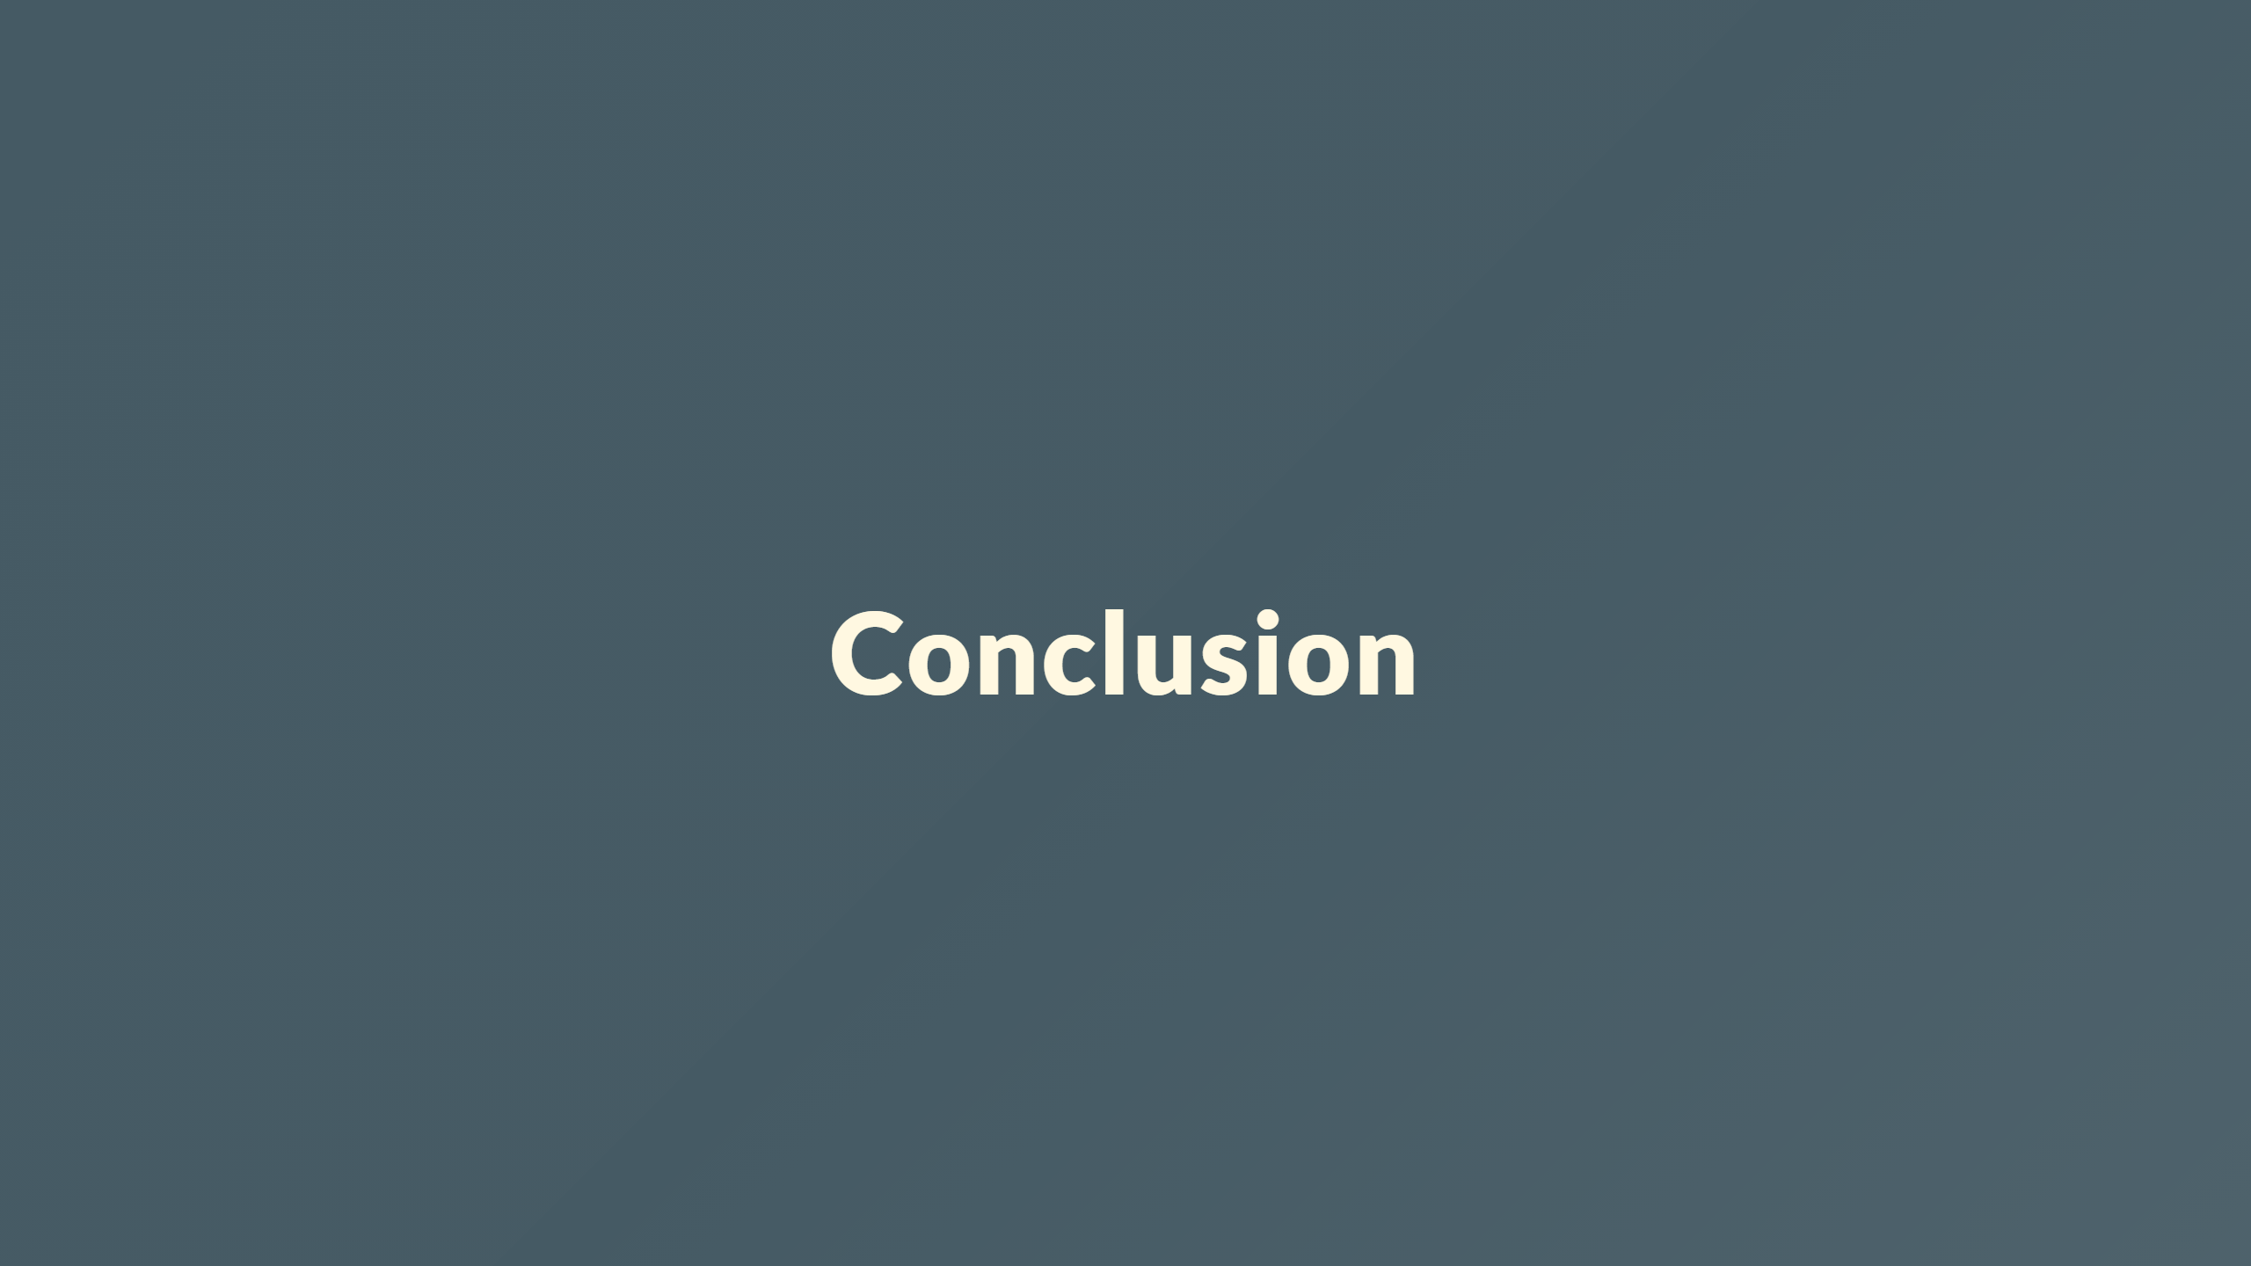

Slide 46
